Slide 1
J-PARC MLFにおけるステライルニュートリノ探索実験
平岩 聡彦
阪大RCNP
on behalf of the J-PARC P56 collaboration
(We requested the 1st stage approval at the 19th PAC on Dec 2014.)
Contents
Introduction
- LSND
- Current status of sterile neutrino searches.
Sterile neutrino search at MLF (J-PARC P56)
- Experimental principle.
- Experimental features.
Background measurement at candidate sites
- Results
- Sensitivity
Summary and outlook

Slide 2
Introduction

Slide 3



LSND anomaly
PRD 64 (2001) 112007
LSND:
signal: ν_{μ} → ν_{e} (appearance)
Using μ⁺ decay at rest (μ⁺ DAR):
Detected by Liq. Scinti.:
ν_{e}p → e⁺n (IBD),
followed by neutron capture γ
(2.2 MeV)
Excess events:
87.9 ± 22.4 ± 6.0 events.
→ 3.8 σ evidence for oscillation → Sterile neutrino(?)
$$π^{+} ⟶ μ^{+}ν_{μ}$$
$$e^{+}υ_{e}\overline{υ_{μ}}$$
Oscillations ?
$$\overline{υ_{e}}$$

Slide 4
Status of sterile neutrino search (Δm² ~ 1 eV²)
Positive results:
There are several negative results:
- MiniBooNE (disappearance).
- KARMEN etc.
A definite search is awaited. (high statistics and low background)
Experiments | Neutrino source | signal | type | Significance σ
LSND | μ Decay-At-Rest | ν_{μ}→ν_{e} | appearance | 3.8
MiniBooNE | π Decay-In-Flight | ν_{μ}→ν_{e} | appearance | 3.4
 |  | ν_{μ}→ν_{e} | appearance | 2.8
 |  | combined |  | 3.8
Gallium | e capture | ν_{e}→ν_{X} | disappearance | 2.7
Reactors | Beta decay | ν_{e}→ν_{X} | disappearance | 3.0
Notes:
•
Last year we submit a proposal. Tile a search for sterile neutrino at J-PARC MLF.
This proposal have a name P56. P means proposal, not approved experiment yet. at present.
I mentioned Main physics is to get an answer the anti-nyu my to anti-nyu e oscillation at eV2 region.
For this purpose, high confidence level should be required.
This table shows evidence result for nyu my to nyu e oscillation.
For P56, good sensitivity reruired superior to last experiment, then we can concluded.
For good sencitivty , key issue is Backgrond
----- 会議メモ (2014/12/17 15:15) -----
信頼性confidence level
to check these result,
antiがついてない

Slide 5
Sterile neutrino search at J-PARC MLF
(J-PARC P56 experiment)

Slide 6
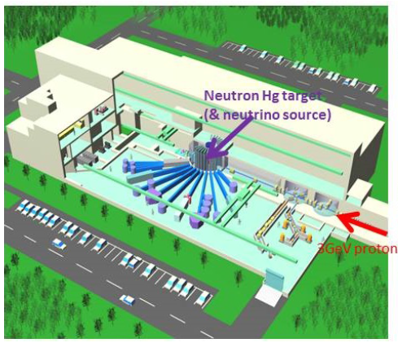
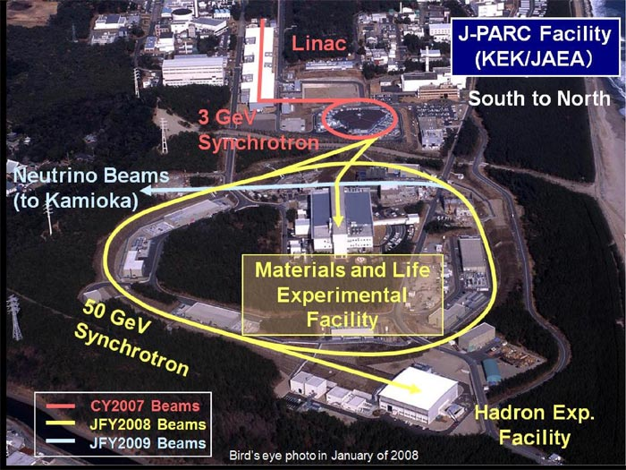
Material and Life science Facility (MLF)
400 MeV Linac
Candidate site (3F)
L = 24 m
R_{apid} C_{ycle} S_{ynchrotron}
Energy:3GeV
Repetition:25Hz
Design Power:1MW
3 GeV Synchrotron
600ns
40ms
100ns x2

Slide 7
J-PARC P56 experiment
Search for the LSND anomaly using μ⁺ decay at rest (μ⁺DAR) :
- ν_{μ} → ν_{e} (appearance).
Detector:
- Gd-loaded liquid scintillator.
(25 tons x 2 ~ total 50 tons)
Measurement principle:
- “Delayed Coincidence”:
- ν_{e} + p → e⁺ + n (IBD)
- 8 MeV γ from n-capture
by Gd ← delayed signal
(capture time
~ several tens μsec)
- E_{ν} = E_{e}(visible) + 0.8 MeV
prompt signal

Slide 8
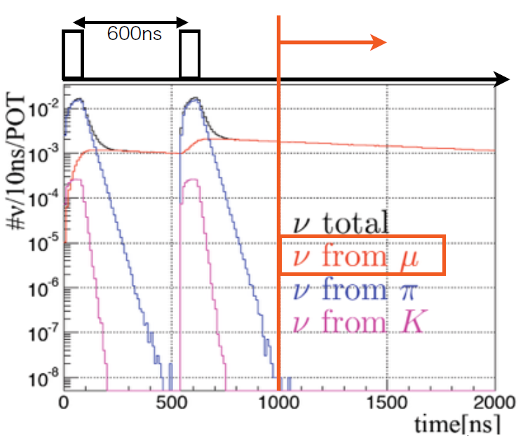
Experimental features
μDAR
beam bunch
Pulsed beam and muon long life time enable the separation of μDAR. (top fig.)
Due to nuclear absorption, neutrinos from π⁻ and μ⁻ decay (main BG) are highly suppressed to the same level of the signals.
→ Signature of oscillation by
spectrum shape. (bottom fig.)
Well-defined energy spectrum shape of ν from μDAR.
Well-known cross section for IBD (ν_{e} + p → e⁺ + n).
Δm² = 5.5 eV²
Neutrino energy

Slide 9
Background measurements at candidate sites

Slide 10
Background measurement
Point1: L ~ 17 m
Point2: L ~ 20 m
Point3: L ~ 40 m
BKG measurements were performed at the candidate sites (MLF 3F). (Apr-Jun 2014)
Detectors:
- 500 kg plastic scintillation counter
(yellow): main detector
- Inner veto counter (red).
- Outer veto counter (green).
2 different data sets:
- beam-on
- beam-off (to subtract the beam-unrelated
BKGs.)
3 different points: point-1, 2, 3.
The results for “point 2”(L ~ 20 m) are presented here.
veto eff:
> 99.9 %

Slide 11
BKG(1): Michel-e from beam fast n
On bunch
Prompt
delayed
Selection criteria
ν_{e} + p→ e⁺ , + n
e₊ + e⁻ →2γ +Gd →γ
Prompt signal:
1 < T_{p} [μs] < 10
20 < E_{p} [MeV] < 60
Delayed signal:
T_{p} < T_{d} [μs] < 100
7 < E_{d} [MeV] < 12
IBD
No activities
time
〜2.2μs
〜30μs
n+C→X+π
→ μ
μ→e
Thermalized n captured by Gd
Michel-e
by beam n
time
Clipping
muons
(Cosmic)
Huge, but rejected by charged veto (eff > 99.9 %)
time
Beam-associated fast neutrons (T > 200 MeV) can produce pions, followed by Michel electrons. (π → μ → e)
Michel electrons from beam fast neutrons:
- Michel-e from beam fast neutron mimics the IBD signals.
The “Michel-e” signals have activities on bunch timing, whereas the “IBD” signals have no activities on bunch timing.

Slide 12
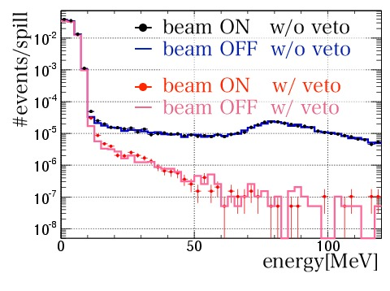
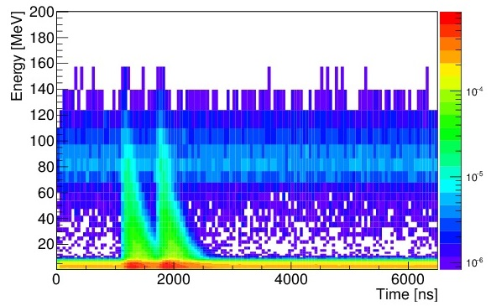
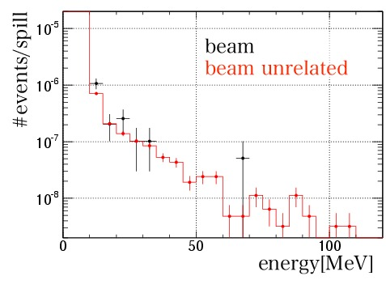
Energy vs Hit Time
Before “on-bunch activity cut”
Beam bunch
projection
Before charged cosmic
veto
after veto
After “on-bunch activity cut”
(require E_{onbunch}>4MeV)
20<E<60MeV 1.75<t(ms)<4.65 | “beam on” /spill/300kW | “beam off” /spill/300kW | subtraction
Before cosmic veto | (1.68±0.03)×10⁻⁴ | (1.64±0.03)×10⁻⁴ | (4.0±4.2)×10⁻⁶
After veto | (1.58±0.09)×10⁻⁵ | (1.52±0.09)×10⁻⁵ | (0.6±1.3)×10⁻⁶
After on-bunch cut | (4.60±1.53)×10⁻⁷ | (4.91±0.28)×10⁻⁷ (expectation) | (-0.3±1.6)×10⁻⁷ (90%C.L. UL；= <13 /5y/50t/MW）
= beam off data (veto) x
accidental on-bunch
p bunch
No Michel-e from beam fast n !!

Slide 13
BKG(2): Accidental backgrounds
Accidental background rate:
R_{acc} = R_{prompt} x R_{delay} x Δ_{vtx} x N_{spill}
- R_{prompt}: BKG rate for prompt signal.
- R_{delay}: BKG rate for delayed signal.
- Δ_{vtx}: Rejection factor of spatial correlation cut
(= 1/50)
- N_{spill}: # of spills (= 1.5 x 10⁹ /5 years)
R_{prompt} and R_{delay} were measured:
- Prompt: cosmic gammas and neutrons.
- Delayed: - Beam associated gammas.
- Beam neutrons

Slide 14
Cosmic γ and n (Prompt):
Measurements using small NE213(< 1 kg)
and NaI (2’’φ x 2’’) @ Tohoku. (identify γ and n)
Scaled to 500 kg scinti. at MLF 3F.(right fig)
→ Consistent within 6%.
Gammas and neutrons are dominant.
(neutrons can be removed by PID of the P56 detector.)
Beam-associated γ (Delayed):
12.5 cm thickness lead under the detector → 1/1000 γ’s
Beam neutrons are thermalized and
captured by the concrete floor, and
γ’s are emitted.

Slide 15
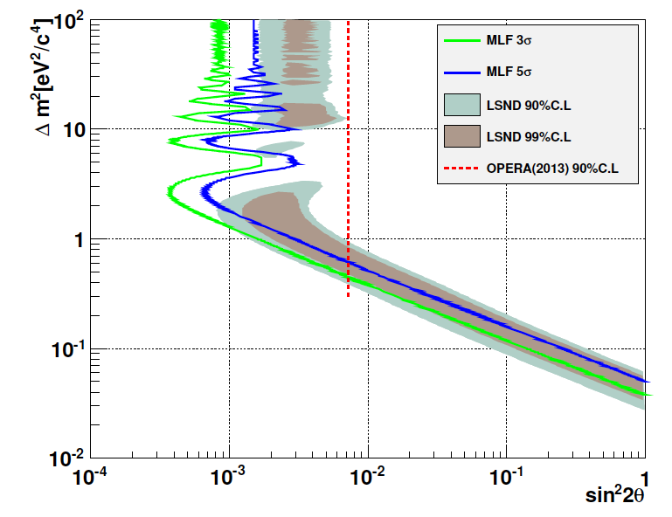
BKG summary and Sensitivity
Source | Contents | Number of Event/50t/5y | Comments
BG | ν_{e} from μ⁻ | 237 | Main BKG. L = 24.
 | ¹²C(ν_{e},e₋)¹²N_{g.s} | 16
 | Michel-e from beam fast n | <13 (90%Cl UL) | Based on measurement.
 | Fast neutron (cosmic) | 37
 | Accidental | 32 | Based on measurement.
Signal |  | 480 | Δm²=3.0 sin²θ=0.003
 |  | 342 | Δm²=1.2 sin²θ=0.003
Sensitivity (MW x 5 years, L = 24 m)
5σ sensitivity as a function of MW x years
Δm₂>2.0eV²
LSND 90%CL
Allowed region
(lower edge)
(high Δm² region)
We can discuss the all LDND allowed region (90% C.L.) with 3σ (MW x 5 years).
Especially for Δm² > 2.0 eV², we can conclude with 5σ (MW x 4 years).

Slide 16
Summary and outlook
We plan to perform a definite search for sterile neutrinos at J-PARC MLF.
Background measurements at the candidate sites were performed, and the experimental feasibility was examined.
We can conclude all the LSND allowed regions (90 % C.L.) with 3σ. (1MW x 5 years)
We can start the experiment within 1-2 years after getting the budgets.
New challengers, especially young scientists, are very welcome. Please join us !!

Slide 17
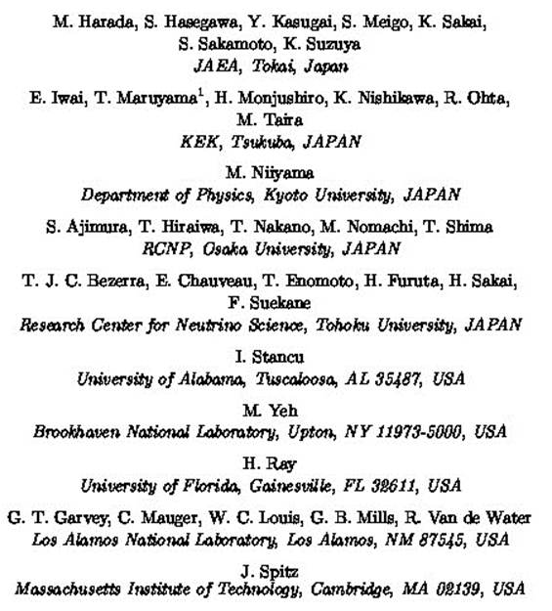
J-PARC P56 collaboration

Slide 18
Backup slide

Slide 19
Success in RCS 1-MW trial
NOTE: This is a very short term test.

Slide 20
BKG(2): Accidental BKG for “Prompt”
Acccidental BKG:
R_{acc} = R_{prompt} x R_{delay} x Δ_{vtx} x N_{spill}
- R_{prmpt}, R_{delay}: BG rates for prompt and delay.
- Δ_{vtx}: spatial correlation (rejection power: 1/50)
- N_{spill}: # of spills: 3x10⁸/year
Measurement @ Tohoku (Left figure):
- Using NaI and NE213 (w/ PID capability), surrounded by cosmic veto counters.
- ratio: γ : n = 3 : 1 (20 < E [MeV] < 60)
Measurement @ MLF 3F (right figure):
- Consistent with the rate predicted by the Tohoku results within 6 %.
γ’s and neutrons are dominant. (neutrons can be rejected by PID)
x 30 larger than that in proposal !!

Slide 21
BKG(3): Accidental BKG for “Delayed“ (beam γ)
Event rate @ “point 2”:
> 1 kHz (E > 1 MeV)
10 times larger than that @ “point 3”
Assumption:
beam associated neutrons are thermalized and captured by the concrete floor and γ’s are emitted.
→ It can well reproduce the measured spectrum.
Beam γ’s can be reduced by putting 12.5 cm thickness lead under the detector down to 1/10.
(Checked by small plastic scintillator counter.)
Energy spectra for “delayed”

Slide 22
BKG(4): Accidental BKG for “Delayed“ (beam n)
Beam bunch
Beam associated neutron (T_{n} > 10 MeV) can reach the fiducial volume and are thermalized and captured by Gd.
→ Delayed BKG: 0.016/spill/MW/25t
Strong spatial correlation between “on-bunch neutron” and “delayed captured γ”
DVTX_{OB-delayed} cut:
→ Delayed n rate: 4x10-4 /spill/MW/25t
Signal inefficiency due to accidental on-bunch hit:
< 2.0 %
On-bunch n

