Slide 1
Double Chooz Results on θ₁₃ and More!
Thiago J. C. Bezerra
東北大学
ニュートリノ科学研究センター
19th ICEPP Symposium
長野県白馬村 – ２０１３年２月１８日

Slide 2
Contents
Reactor Neutrino and θ₁₃
Double Chooz Experiment
Results on θ₁₃
Near Detector and Beyond θ₁₃
Conclusions

Slide 3
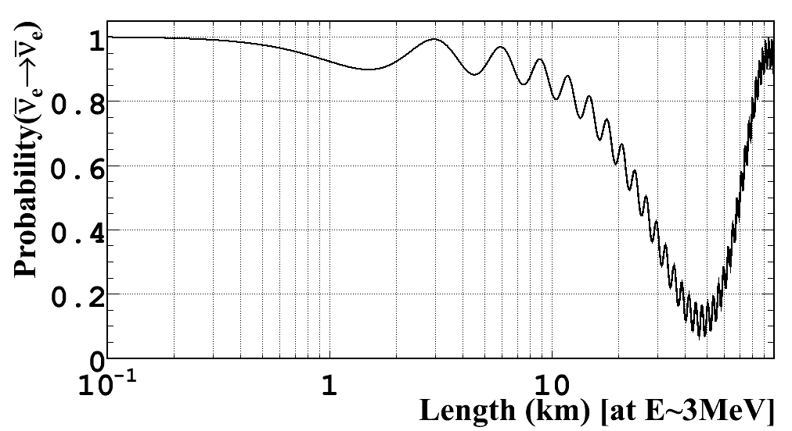
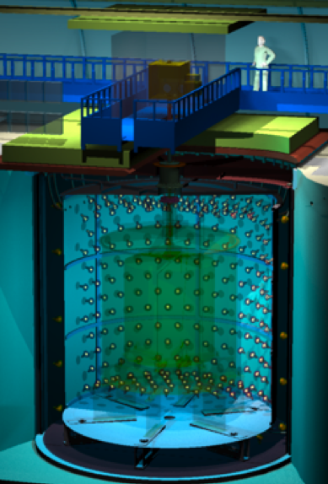
Reactor Neutrinos and θ₁₃
Reactor is a free and rich electron antineutrino source
Direct measurement of θ₁₃ with no parameter degeneracy
  Reactor neutrino survival probability
Simple 2 flavor oscillation formula is valid at L~1km with no matter effect
sin²2θ₁₃
|Δm₃₁²|
sin²2θ₁₃ = 0.1
|Δm₃₁²| = 2.5x10⁻³eV2

Slide 4
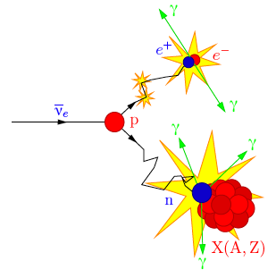
Reactor Neutrinos and θ₁₃
Reactor is a free and rich electron antineutrino source
Direct measurement of θ₁₃ with no parameter degeneracy
Background is strongly suppressed by delayed coincidence
Prompt signal:
positron + annihilation γ’s:
1 ~ 8 MeV
Delayed signal:
γ’s from neutron capture
on Gd: 8 MeV
Time interval:
Δt ~ 30 μsec

Slide 5
Reactor Neutrinos and θ₁₃
Reactor is a free and rich electron antineutrino source
Direct measurement of θ₁₃ with no parameter degeneracy
Background is strongly suppressed by delayed coincidence
Flux expectation within 2% uncertainties
Systematic uncertainties are further reduced (<1%) using 2 detectors at different baselines
sin²2θ₁₃ = 0.1
|Δm₃₁²| = 2.5x10⁻³eV2

Slide 6
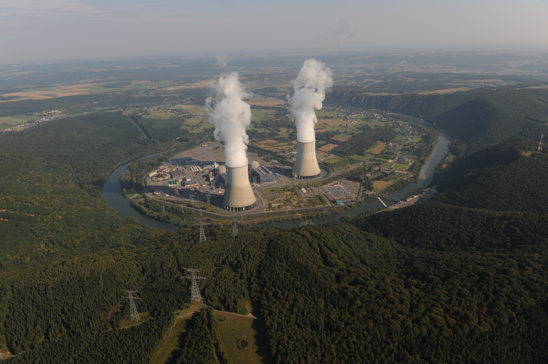


Double Chooz Experiment
ν_{e}
Near Detector
L = 400m
10m³ target
120m.w.e.
2014 ~
Far Detector
L = 1050m
10m³ target
300m.w.e.
April 2011 ~
Chooz Reactors
4.27GW_{th} x 2 cores
6

Slide 7








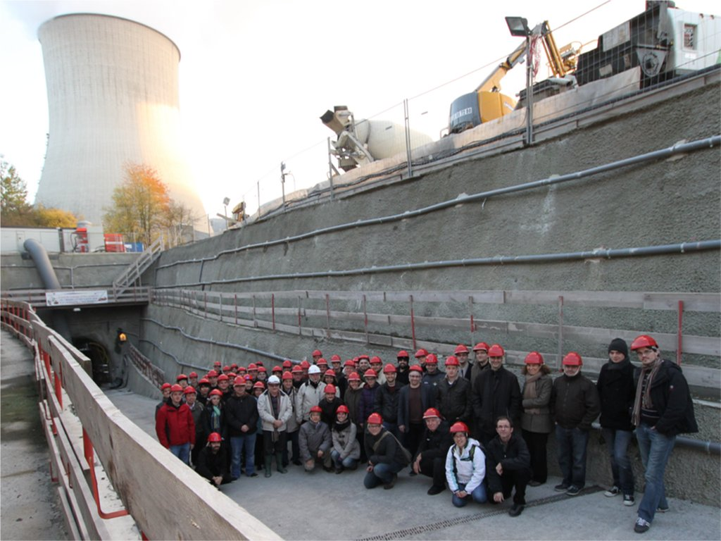
Double Chooz Collaboration
Brazil
France
Germany
Japan
Russia
Spain
USA
CBPF
UNICAMP
UFABC
APC
CEA/DSM/IRFU:
SPP
SPhN
SEDI
SIS
SENAC
CNRS/IN2P3:
Subatech
IPHC
EKU Tübingen
MPIK Heidelberg
RWTH Aachen
TU München
U. Hamburg
Tohoku U.
Tokyo Inst. Tech.
Tokyo Metro. U.
Niigata U.
Kobe U.
Tohoku Gakuin U.
Hiroshima Inst.
Tech.
INR RAS
IPC RAS
RRC Kurchatov
CIEMAT-Madrid
U. Alabama
ANL
U. Chicago
Columbia U.
UCDavis
Drexel U.
IIT
KSU
LLNL
MIT
U. Notre Dame
U. Tennessee
Spokesperson:
H. de Kerret (IN2P3)
Project Manager:
Ch. Veyssière (CEA-Saclay)
Web Site:
www.doublechooz.org/

Slide 8
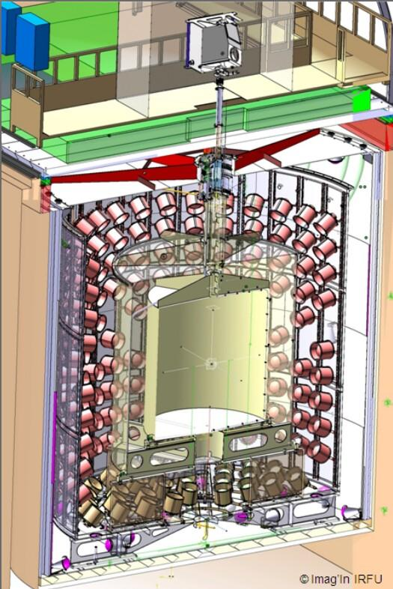
Double Chooz Detector
Outer Veto: Plastic scintillator strips
  Identify cosmic μ
Steel shield (15cm thick)
ν-target:
Gd loaded (1g/l) liquid scint. (10m³)
  Target of neutrino interaction
  Neutrons captured on Gd
Acrylic vessel
γ-catcher: Liquid scintillator (22m³)
  Measure γ’s escaped from ν-target
Acrylic vessel
Buffer:
Mineral oil (110m³) & 390 10-inch PMT
  Reduction of environmental γ’s
Steel tank
Inner Veto:
Liquid scintillator (90m³) & 78 8-inch PMT
  Identify cosmicμ& reduction neutrons

Slide 9
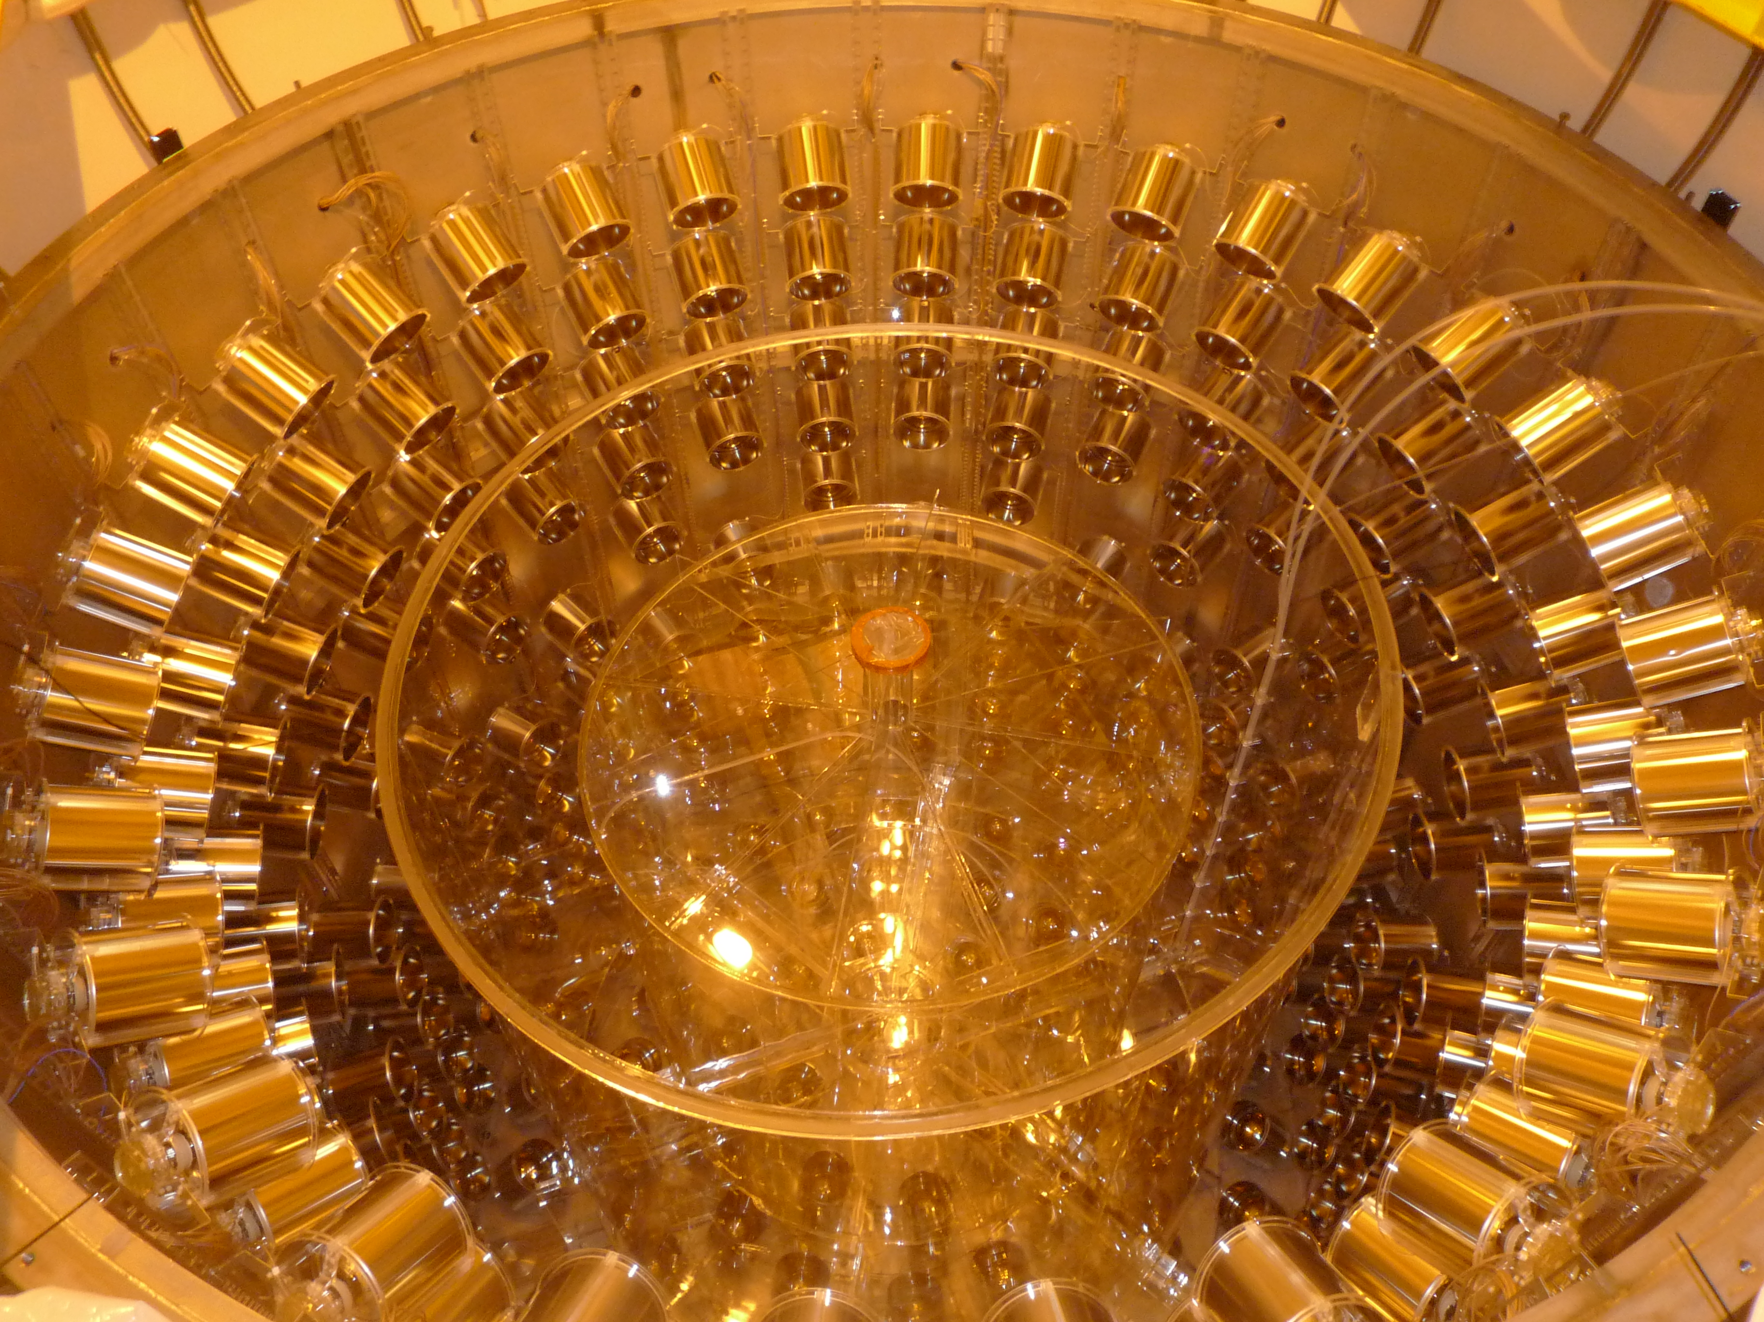
Double Chooz Detector
Buffer
γ-catcher
ν-target

Slide 10
Achievements of Double Chooz
Pioneered reactor experiments (improvements form CHOOZ)
  Experimental concept to use 2 detectors
  New detector structure
  4 layers detector structure becomes standard of forthcoming reactor experiments
  Low background measurement (S/N~20) proved by reactor OFF
  Stable Gd loaded LS developed
Announced results in November 2011
  First θ₁₃ measurement by short baseline reactor experiment since CHOOZ
  Indication of non-zero θ₁₃ at 94.6% C.L. and hint for a large value of θ₁₃
  Evidence for non-zero θ₁₃ at 3σ by combination with long baseline experiments (MINOS & T2K)

Slide 11
Improvements from the 1st Result
Doubled statistics
  96.8 → 227.9 days live time
  4121 → 8249 neutrino candidates
Improved analysis
  Energy calibration improved
    Readout MC tuning
    Corrections for non-linear gain, position dependence, stability
  Additional muon veto implemented (⁹Li reduction)
  OV veto implemented (part of data)
  Separate data into two periods based on thermal power
    1) Both reactors on: 139.3 days
    2) One reactor off: 88.7 days

Slide 12
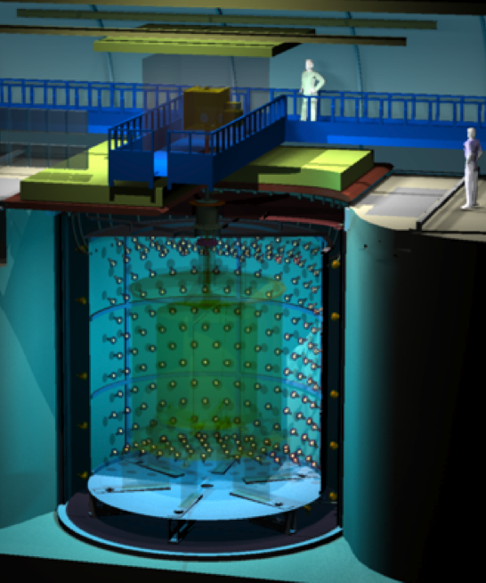
Neutrino Selection
Muon veto
  No coincidence signal in IV
  Δt_{μ} > 1 msec
Prompt event
  0.7 < Evis < 12.2 MeV
  PMT light noise cuts
Delayed event
  6 < Evis < 12 MeV
  PMT light noise cuts
ν_{e}
e⁺
Delayed coincidence
  2 < Δt < 100 μsec
p
n
Gd
Multiplicity
  No extra events around signal
Further BG reduction
  Δt_{μ} > 500 msec (E_{μ} > 600MeV)
  No coincidence signal in OV

Slide 13
Neutrino Selection
Muon veto
  No coincidence signal in IV
  Δt_{μ} > 1 msec
Prompt event
  0.7 < Evis < 12.2 MeV
  PMT light noise cuts
Delayed event
  6 < Evis < 12 MeV
  PMT light noise cuts
Delayed coincidence
  2 < Δt < 100 μsec
Multiplicity
  No extra events around signal
Further BG reduction
  Δt_{μ} > 500 msec (E_{μ} > 600MeV)
  No coincidence signal in OV

Slide 14
Neutrino Selection
Muon veto
  No coincidence signal in IV
  Δt_{μ} > 1 msec
Prompt event
  0.7 < Evis < 12.2 MeV
  PMT light noise cuts
Delayed event
  6 < Evis < 12 MeV
  PMT light noise cuts
Delayed coincidence
  2 < Δt < 100 μsec
Multiplicity
  No extra events around signal
Further BG reduction
  Δt_{μ} > 500 msec (E_{μ} > 600MeV)
  No coincidence signal in OV

Slide 15
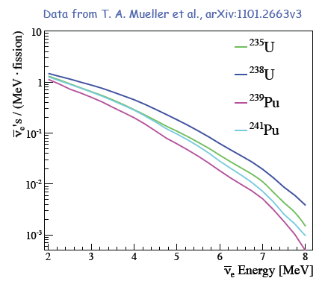
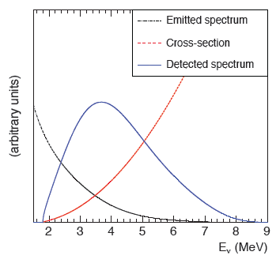
Reactor Neutrino Simulation
Flux Source
  Beta-decays from neutron-rich fission products in nuclear reactors
  ~ 200 MeV / fission
  ~ 6 neutrinos / fission
  ~ 2 x 10²⁰ neutrinos / GW_{th}

Slide 16
Reactor Neutrino Simulation
Neutrino yield per fission
Reactor neutrino flux calculation
Inverse β decay reaction (whole volume)
Detector simulation (Geant4 base)
Bugey4 measurement as anchor point
Fission fraction in Chooz core
Uncertainty on neutrino flux suppressed using Bugey4 measurement: 2.7% →1.8%
Readout and trigger simulation

Slide 17
Neutrino Candidates
2 reactors on (~60%)
1 reactor on (~40%)
No ⁹Li reduction and OV veto
Background not subtracted
Neutrino rate consistent with expectation
Both reactors off (~1 day)

Slide 18
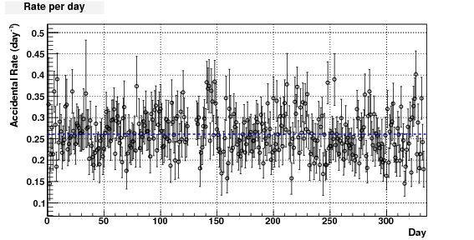
Background: Accidental
μ
Accidental coincidence:
E.g. Environmental γ → Fast-neutron
γ
n
Gd
BG estimated from coincidence in off-time window
0.261±0.002 event/day
BG rate is stable

Slide 19
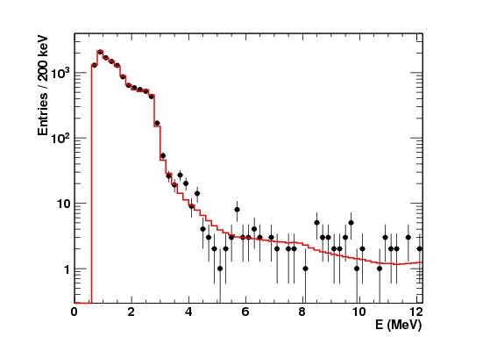
Background: Accidental
μ
Accidental coincidence:
E.g. Environmental γ → Fast-neutron
Preliminary
Prompt (accidental BG)
Single spectrum scaled
γ
n
Gd
BG estimated from coincidence in off-time window
0.261±0.002 event/day
BG rate is stable

Slide 20
Background: Fast n + stop μ
μ
Correlated background:
Fast-n: recoils proton → captured on Gd
Stop μ: μ → delay (mostly tagged by OV)
p
n
Gd
BG estimated from IV and OV coincident events
  0.67 ± 0.20 event/day

Slide 21
Background: ⁹Li
μ
Spallation products from muon:
⁹Li → e- + n + ⁸Be
(τ ~ 200 msec)
E_{μ} > 600MeV
ΔL < 80cm
e–
⁹Li
n
Gd
BG estimated from spatial and time coincidence with muons
1.25 ± 0.54 event/day
  2.05 ^{+0.62}_{-0.52} without ⁹Li reduction

Slide 22
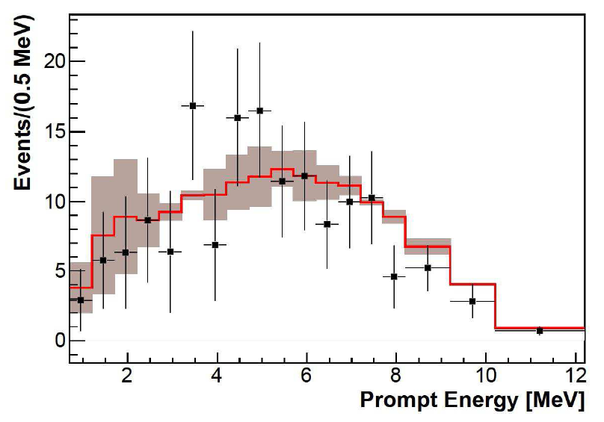
Background: ⁹Li
μ
⁹Li spectrum prediction + error
DC measurement (⁹Li enriched)
e–
⁹Li
n
Gd
BG estimated from spatial and time coincidence with muons
1.25 ± 0.54 event/day
  2.05 ^{+0.62}_{-0.52} without ⁹Li reduction

Slide 23
Systematic Uncertainties on Rate
Source |  | Uncertainty w.r.t. signal (previous analysis)
Statistics |  | 1.1% (1.6%)
Flux |  | 1.7%
Detector | Energy response | 0.3% (1.7%) | 1.0% (2.1%)
 | E_{delay} containment | 0.7%
 | Gd fraction | 0.3%
 | Δt cut | 0.5%
 | Spill in/out | 0.3%
 | Trigger efficiency | <0.1%
 | Target H | 0.3%
Background | Accidental | <0.1% | 1.6% (3.0%)
 | Fast neutron + stop μ | 0.5% (0.9%)
 | ⁹Li | 1.4% (2.8%)
Further constraint by a fit to spectrum

Slide 24
Oscillation Analysis Method
Covariance matrix with penalty terms
Binned Rate + Spectral Shape Fit
Total Cov. Matrix
Fit Parameter “Pulled” Term

Slide 25
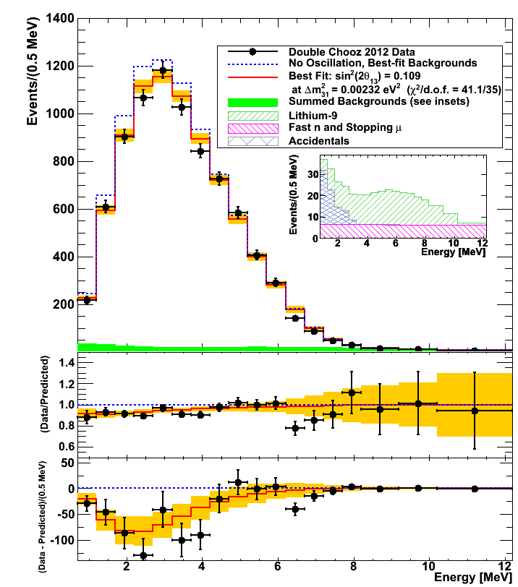
Double Chooz Results
NOTE:
In a fit, dataset is divided into two periods based on reactor power
Preliminary
Rate only: sin²2θ₁₃ = 0.170 ±0.035(stat) ±0.040(syst)
Rate+Shape: sin²2θ₁₃= 0.109 ±0.030(stat) ±0.025(syst)
χ²/dof = 42.1/35
sin²2θ₁₃ = 0 is excluded at 99.8% (2.9σ)
(frequentist study)
Phys. Rev. D 86, 052008 (2012)

Slide 26
Observed vs. Expected Rate
2 events observed in 0.84 days live-time with both reactors off
(= 2.2 event/day)
→ Background rate consistent with estimation
(2.2 ±0.6 event/day)
Best fit to expected rate:
sin²2θ₁₃ = 0.19 ± 0.06
BG rate = 2.9 ± 1.1 event/day

Slide 27
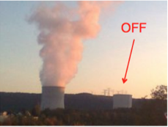
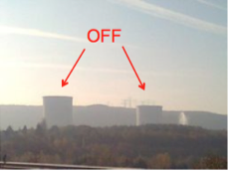
Reactor Off-Off: Total Background
Background measurement with both reactors off is unique capability of Double Chooz
There were two reactor off-off periods so far:
1. Oct.2011, 0.84 days (live time)
2. Jun.2012, 6.00 days (live time)
Observed events: 8 (1.2 ± 0.4 evt/d)
Expected rate: 2.2 ± 0.6 evt/d

Slide 28
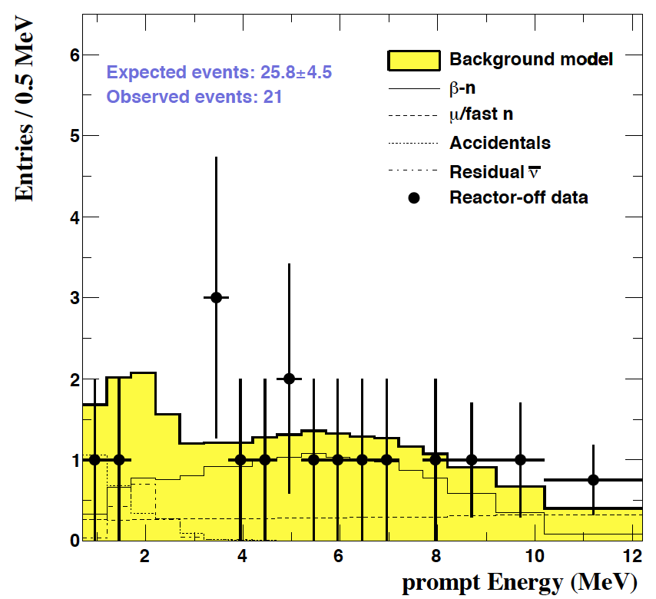
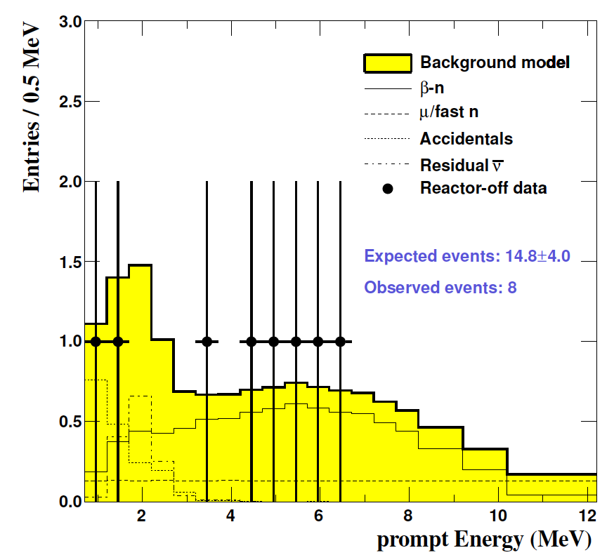
New Off-Off Data
DC 1st Pub Selection Cut
DC 2nd Pub Selection Cut
Direct measurement of backgrounds using reactor-off data in Double Chooz
Y. Abe et al. (Double Chooz Collaboration)
[Phys. Rev. D 87, 011102 (2013)] Published Tue Jan 8, 2013

Slide 29
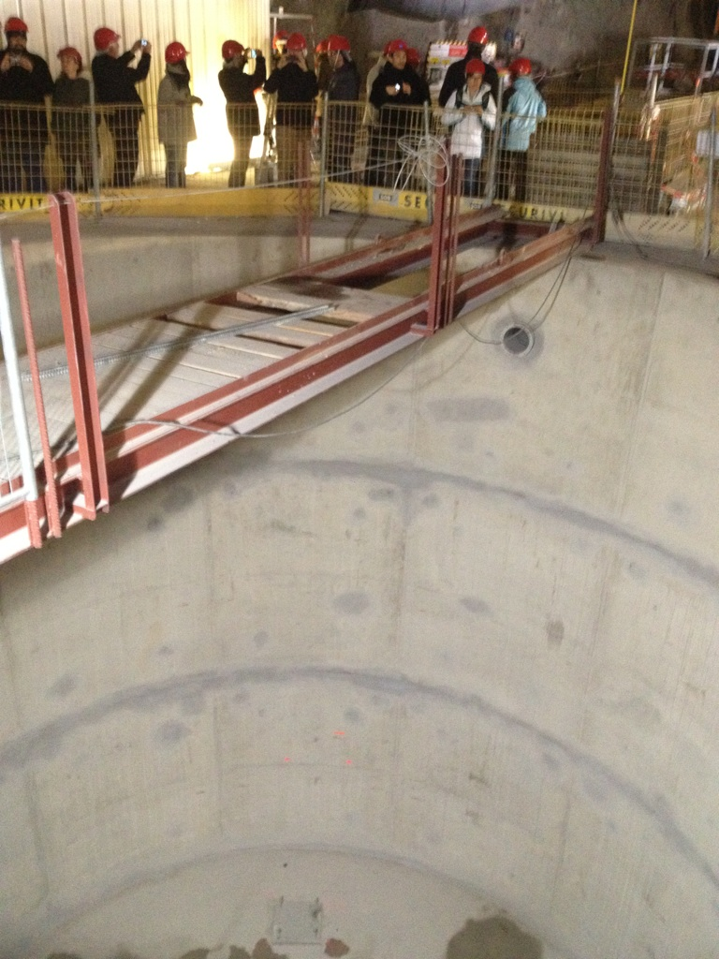
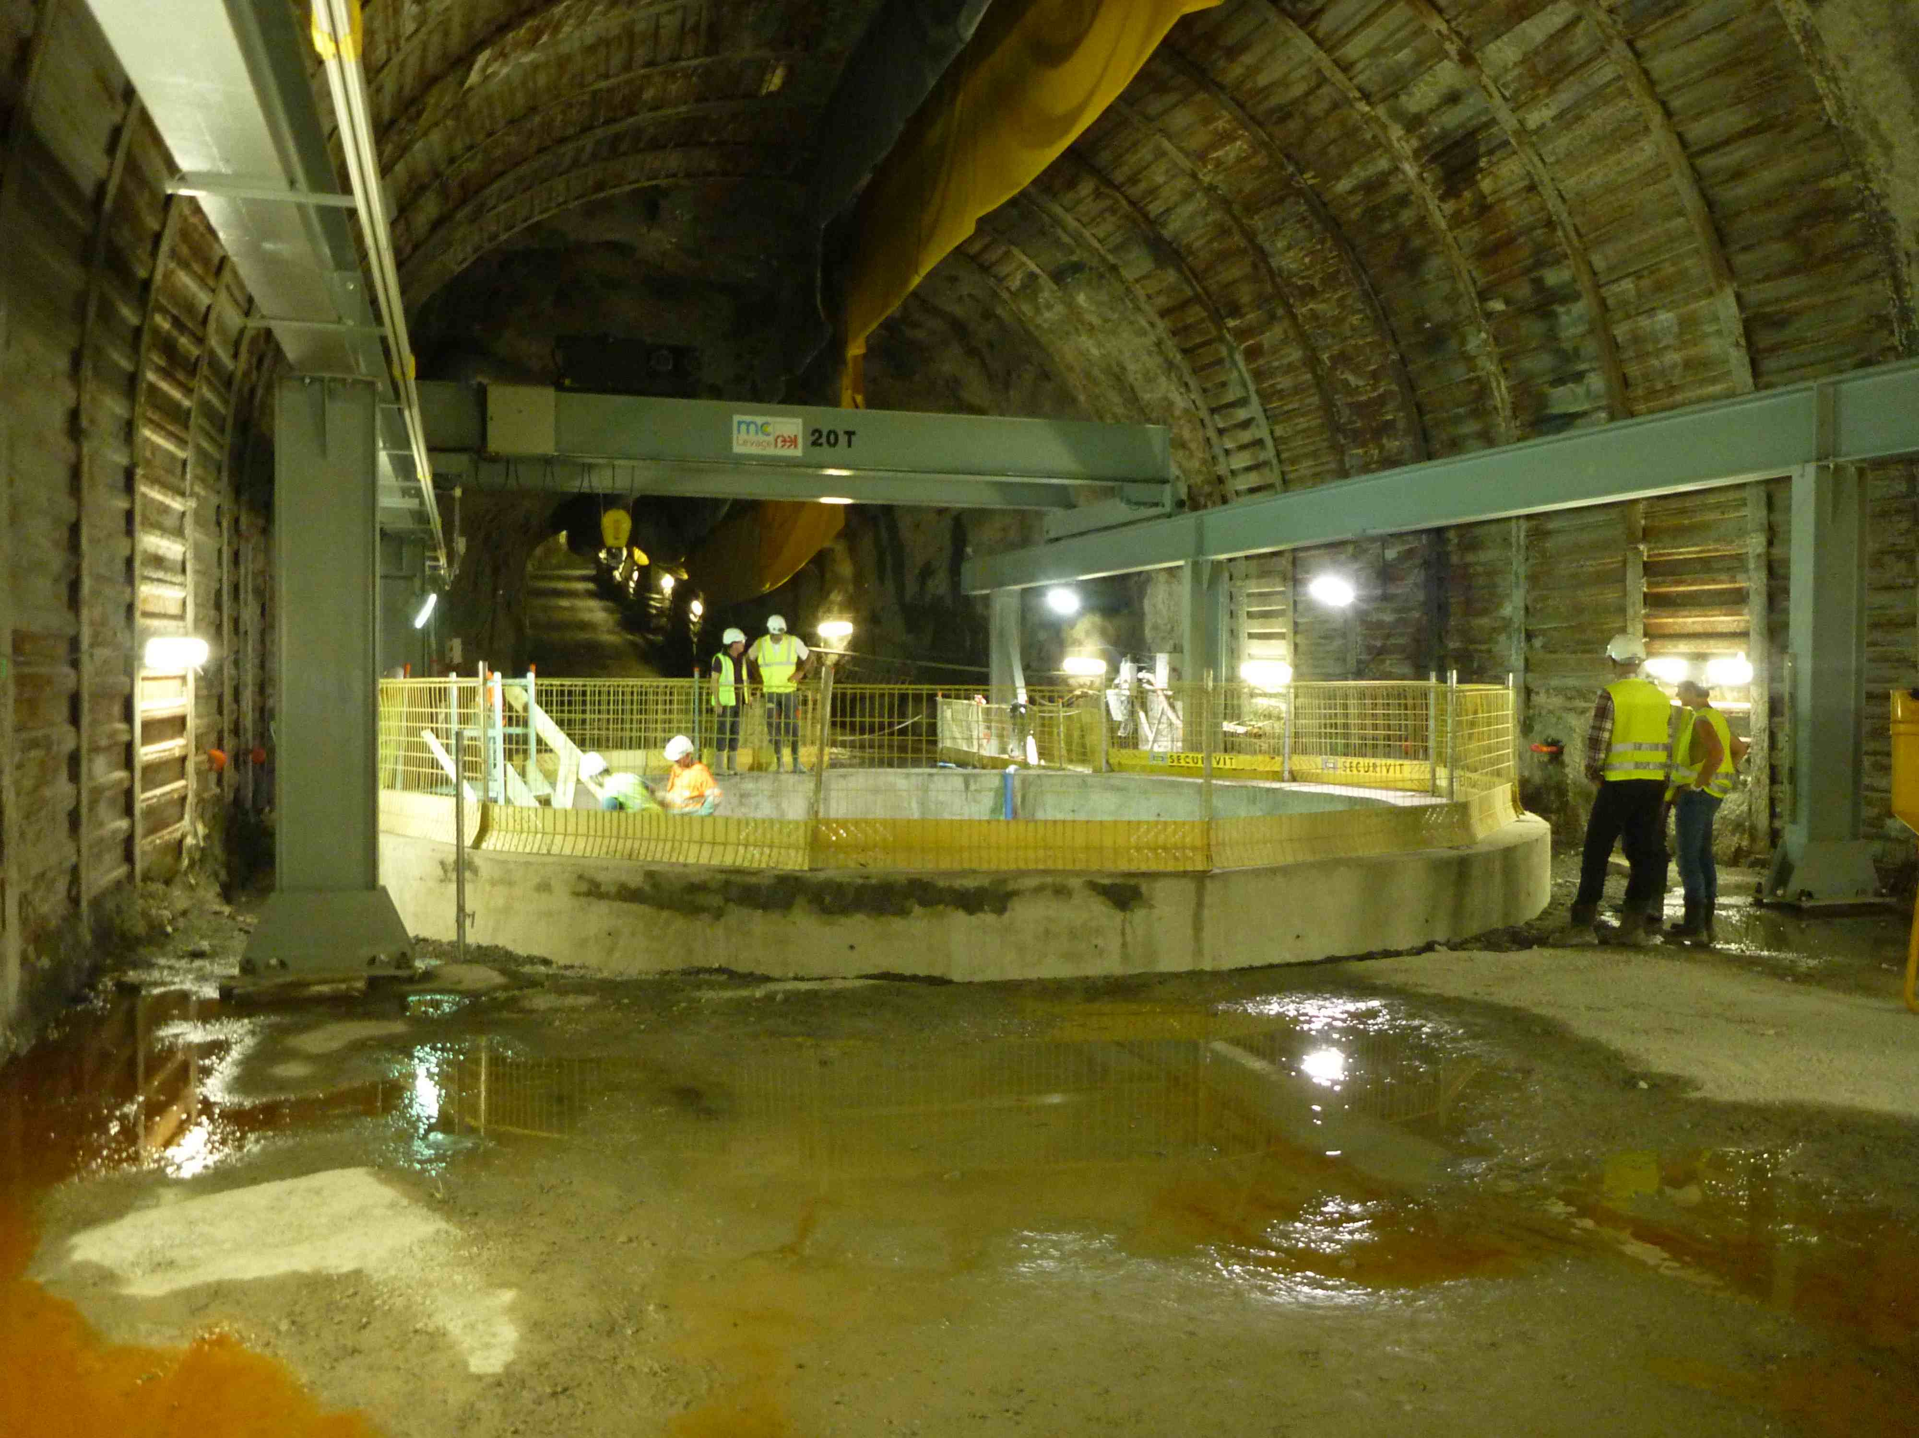
Near Detector
Near detector laboratory excavation completed
Start data taking by beginning of 2014

Slide 30
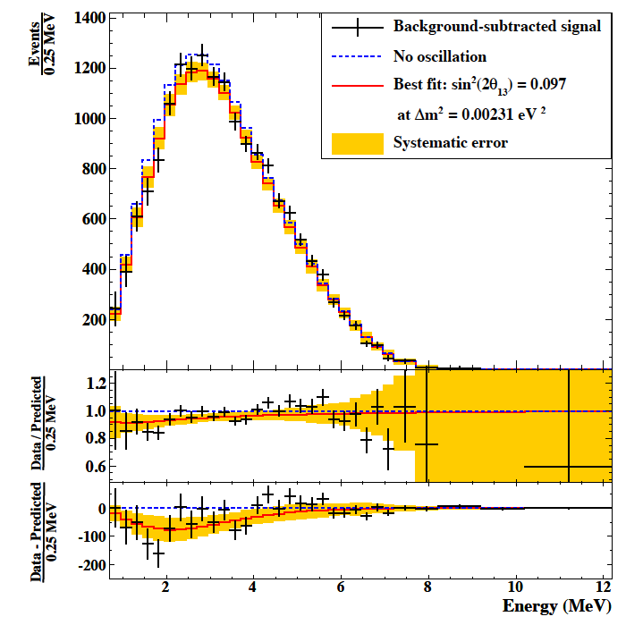
n-H Capture
  Increase statistics by using gamma catcher volume
  Signal expectation : 8440 (Gd) 17690 (H)
  More systematics
  Background estimation : 497.1 (Gd) 18990 (H)
sin²2θ₁₃= 0.097 ±0.034(stat) ±0.034(syst)
using the same data sample, but different events
sin²2θ₁₃= 0.109 ±0.030(stat) ±0.025(syst)
(Gd)
First Measurement of θ₁₃ from Delayed Neutron Capture on Hydrogen in the Double Chooz Experiment
arXiv:1301.2948 [hep-ex]

Slide 31
Double Chooz
Beyond θ₁₃

Slide 32
Double Chooz Beyond θ₁₃
Constrain to |Δm²₃₁|
  Are the reactors experiments really measuring θ₁₃?
      Reactors experiments are using Δm²₃₂ in their analysis.
  Is it correct to say Δm²₃₁ ~ Δm²₃₂?
  Global fit of reactor neutrino data leads to:
      (information from detectors at different base-lines)
Preliminary

Slide 33
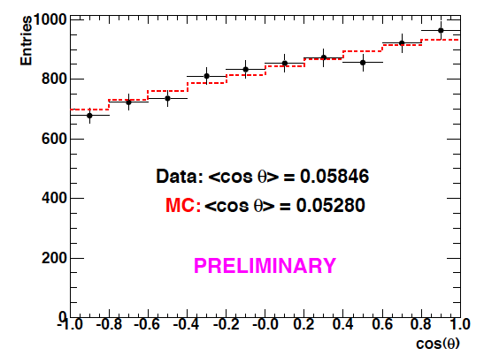
Double Chooz Beyond θ₁₃
Neutrino Directionality
  Detection of a neutrino source position
  Neutrino Displacement vector (delayed – prompt vertices)
  Reactor-Detector Vector
        cos(θ) tends more towards +1 than -1:
        Neutrino candidate source located at:
        84º within 6º half-aperture cone
        MC indicates 83º within 7º

Slide 34
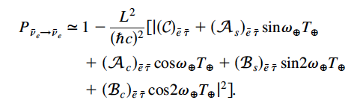
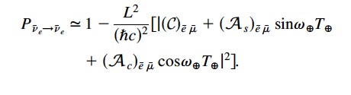
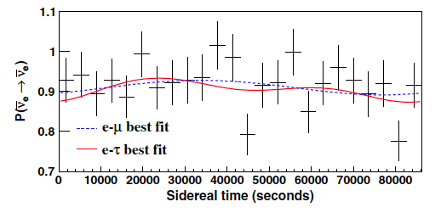
Double Chooz Beyond θ₁₃
Lorentz Violation
  Test if Lorentz invariance is violated at the Planck scale.
    By natural interferometer of neutrino oscillation
    Lorentz violation oscillation at electron to tau neutrino sector:
    Lorentz violation oscillation at electron to muon neutrino sector:
No modulation was observed and the first limits on 16 of the SME coefficients were set.
First test of Lorentz violation with a reactor-based antineutrino experiment
Phys. Rev. D. 86. 112009

Slide 35
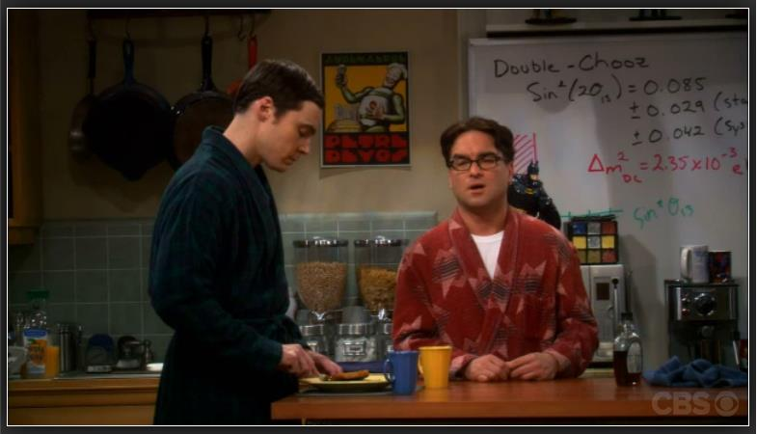
Double Chooz Beyond θ₁₃
Entertainment
  CBS Network Comedy “The Big Bang Theory”
  Season 5 – Episode 11, “The Speckerman Recurrence”

Slide 36
Conclusion
Double Chooz updated results
  Doubled statistics (4121 → 8249 neutrino candidates)
  Improved analysis
    Background Reduction
    Systematic Uncertainties
sin²2θ₁₃ = 0.109 ±0.030(stat) ±0.025(syst)
sin²2θ₁₃ = 0 is excluded at 99.8% (2.9σ)
Near Detector is expected to start data taking on early 2014

Slide 37
Back Up

Slide 38
Reactor vs. neutrino beam
Reactor neutrino survival probability
θ₁₃
CP-violation
Mass hierarchy
θ₂₃
Muon neutrino oscillation probability

Slide 39
Data sets
Run time:
251.3 days from April 2011 to March 2012
(101 days in previous analysis)

Slide 40
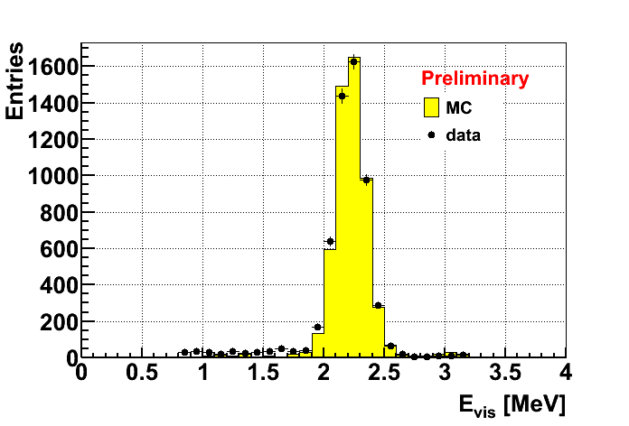
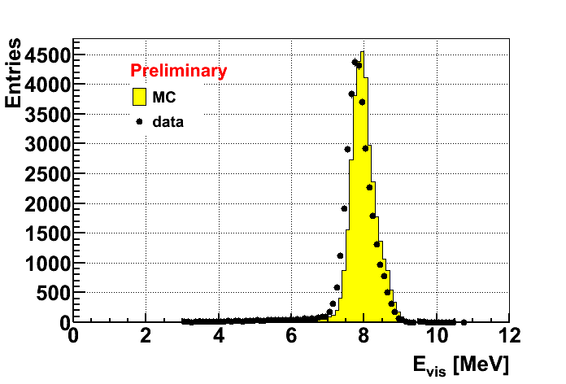
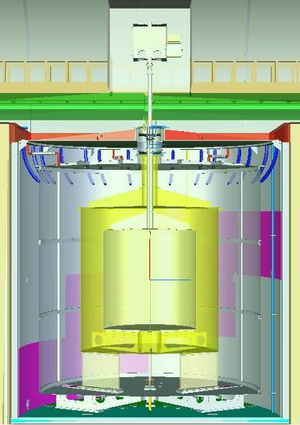
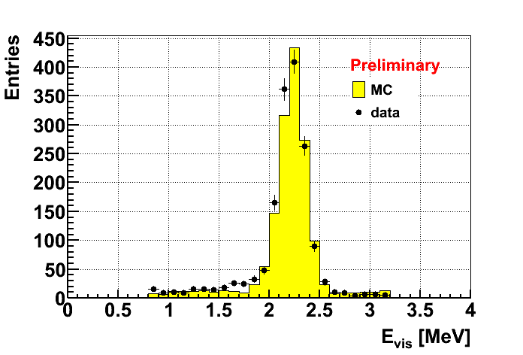
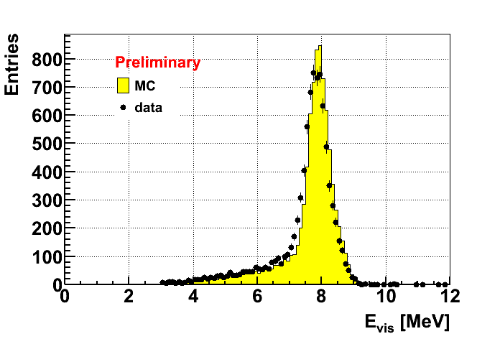
Calibration
²⁵²Cf (n-H)
at center
²⁵²Cf (n-Gd)
at center
²⁵²Cf (n-H)
at bottom
²⁵²Cf (n-Gd)
at bottom

Slide 41
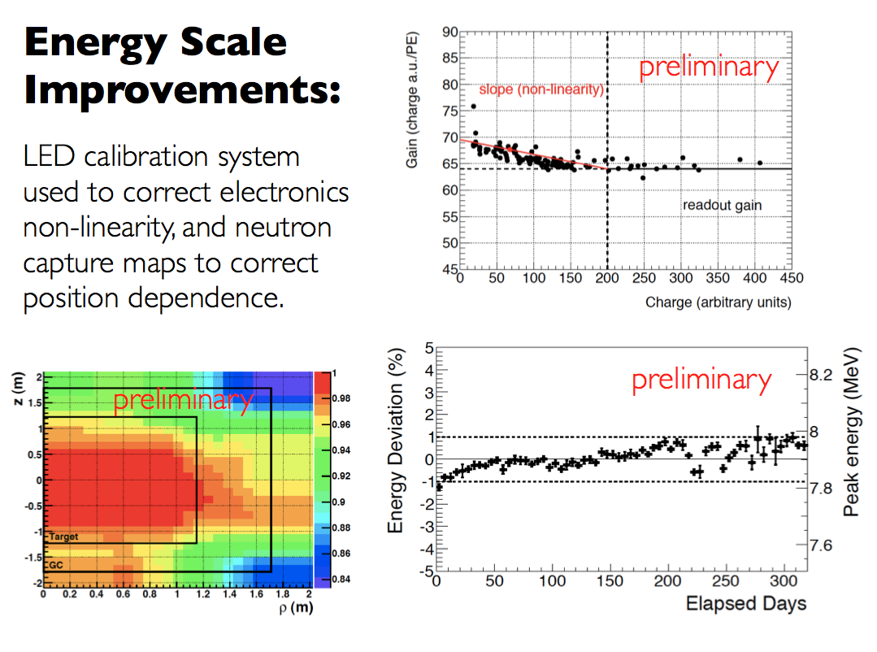

Slide 42
Calibration: stability
Preliminary
Neutron capture on Gd
Neutron capture on H
(after time variation correction)

Slide 43
Vertex position: prompt

Slide 44
Vertex position: delayed

Slide 45
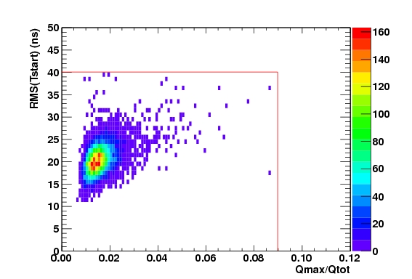
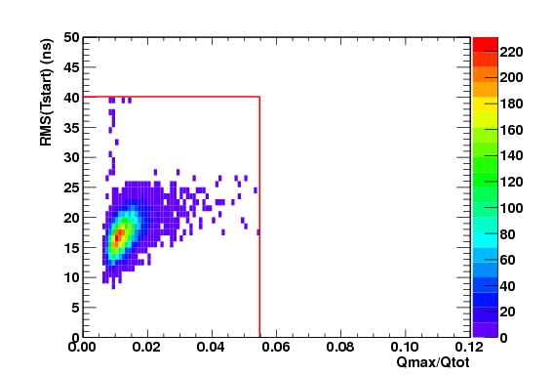
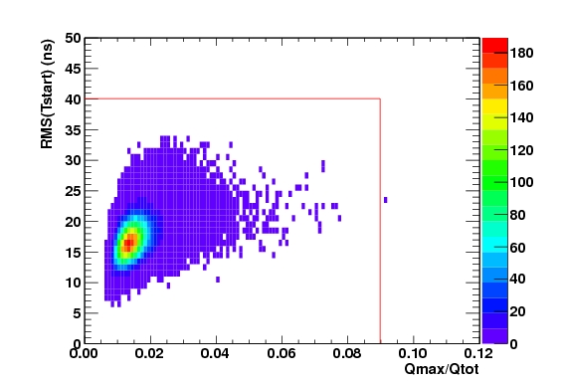
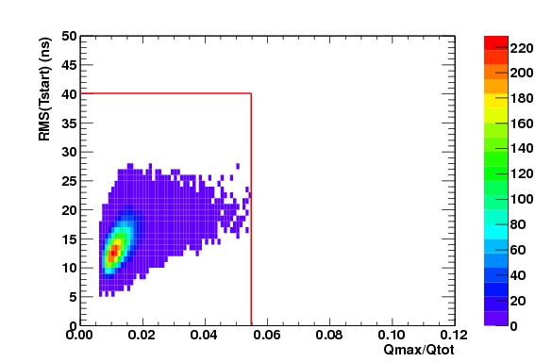
Light noise cut
Preliminary
Preliminary
Data (ν candidates)
Prompt signal
Data (ν candidates)
delayed signal
Preliminary
Preliminary
MC
Prompt signal
MC
delayed signal

Slide 46
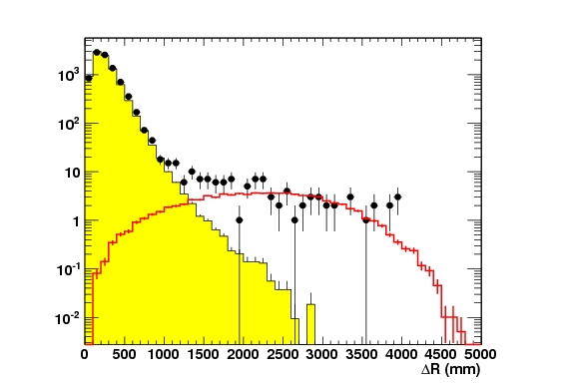
Spatial correlation
Distance between prompt and delayed signals
Neutrino candidates
Neutrino MC
Accidental BG

Slide 47
Fast neutron vs. stop μ

Slide 48
Input/output of pull terms
Source |  | Input | Output
Background | Fast neutron + stop μ | 0.67 ± 0.20 cpd | 0.64 ± 0.13 cpd
 | ⁹Li | 1.25 ± 0.54 cpd | 1.00 ± 0.29 cpd
Energy scale |  | 1.000 ± 0.011 | 0.986 ± 0.007
Δm² |  | (2.32 ± 0.12)×10⁻³ eV² | (2.32 ± 0.12)×10⁻³ eV²

Slide 49
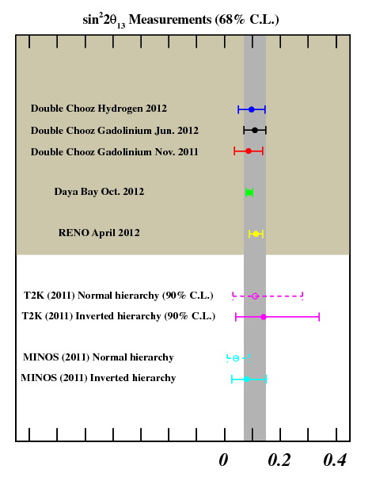

Slide 50
Frequentist studies
sin2²θ₁₃ = 0 hypothesis is excluded at 99.8% (2.9σ)
90% C.L. interval:
0.043 < on sin2²θ₁₃ < 0.18
68% C.L. interval:
0.067 < on sin2²θ₁₃ < 0.15

