Slide 1
MEG実験アップグレードに向けたSiPMを用いた
ポジトロン時間測定器の研究開発
西村美紀 (東大)
他 ＭＥＧコラボレーション

Slide 2
outline
Introduction
  MEG
  Upgrade
Pixelated timing counter
  Concept
Test of prototype of single pixel
  Basic characteristic
  Optimization
Beam test
Summary and Prospects

Slide 3
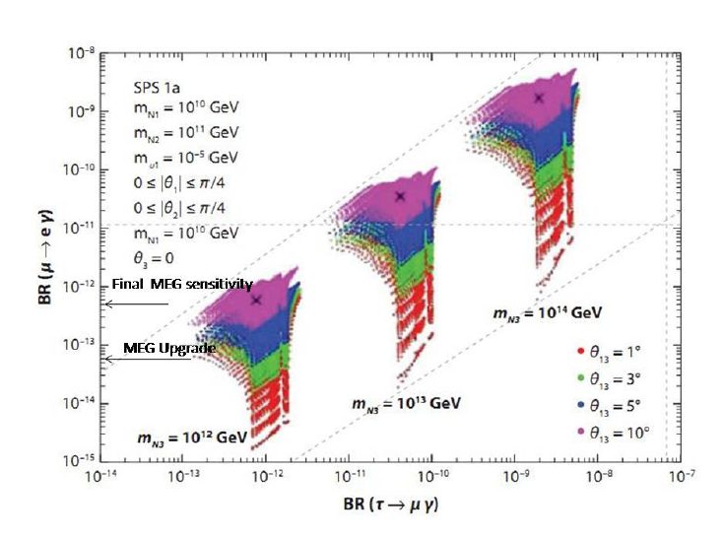
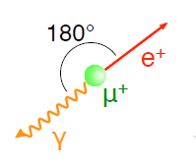
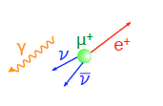
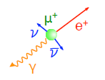
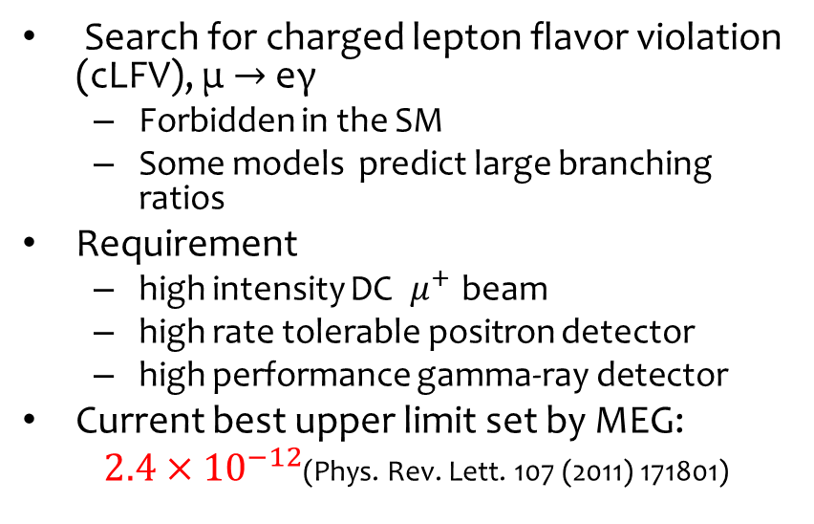
μ → eγ
SUSY-Seesaw
Search for charged lepton flavor violation (cLFV), μ $→$ eγ
  Forbidden in the SM
  Some models predict large branching ratios
Requirement
  high intensity DC ${ μ}^{+}$ beam
  high rate tolerable positron detector
  high performance gamma-ray detector
Current best upper limit set by MEG:
$2.4×{10}^{−12}$(Phys. Rev. Lett. 107 (2011) 171801)
S.Antusch et al, JHEP 0611:090 (2006)
Dominant
at rest
Accidental BG
<52.8MeV
Any angle
Random
Physics BG
(radiative muon decay)
<52.8MeV
Any angle
Time coincidence
Signal
52.8MeV
Back-to-back
Time coincidence

Slide 4
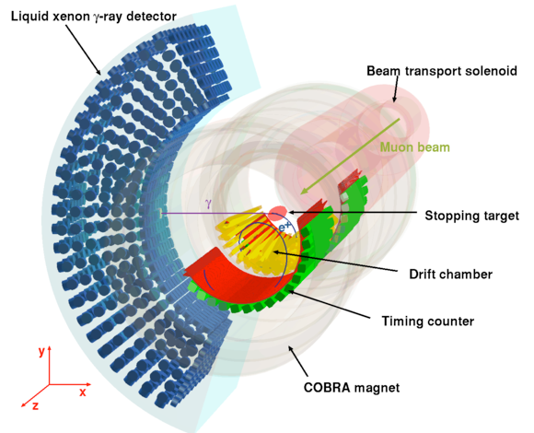
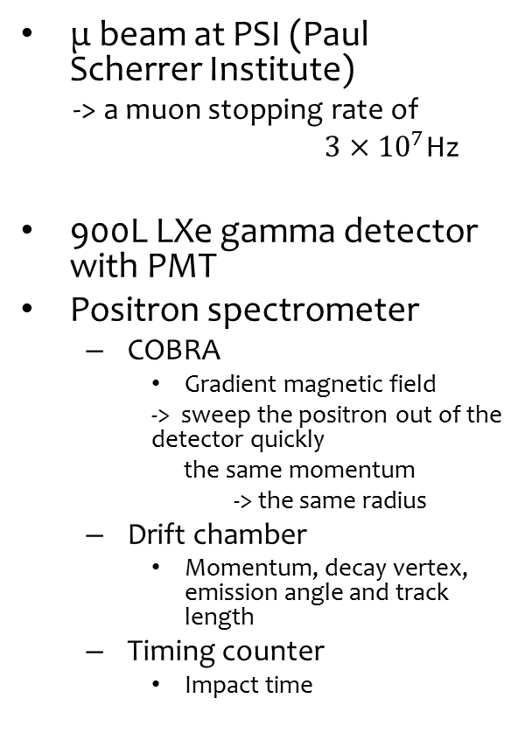

MEG
μ beam at PSI (Paul Scherrer Institute)
-> a muon stopping rate of
$3×{10}^{7}$Hz
900L LXe gamma detector with PMT
Positron spectrometer
  COBRA
    Gradient magnetic field
    -> sweep the positron out of the detector quickly
    the same momentum
    -> the same radius
  Drift chamber
    Momentum, decay vertex, emission angle and track length
  Timing counter
    Impact time
Most stringent upper limit of $2.4×{10}^{−12}$ in summer 2011
Sensitivity goal -> ~$6×{10}^{−13}$ in 2013

Slide 5
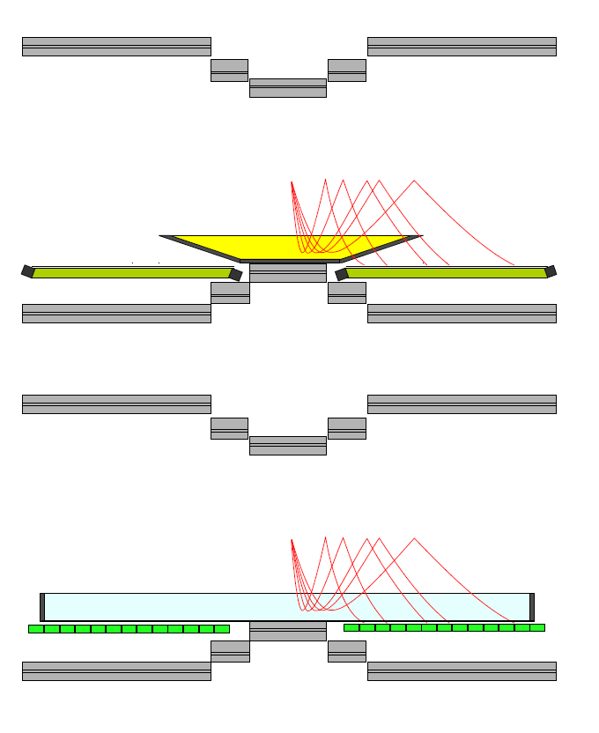

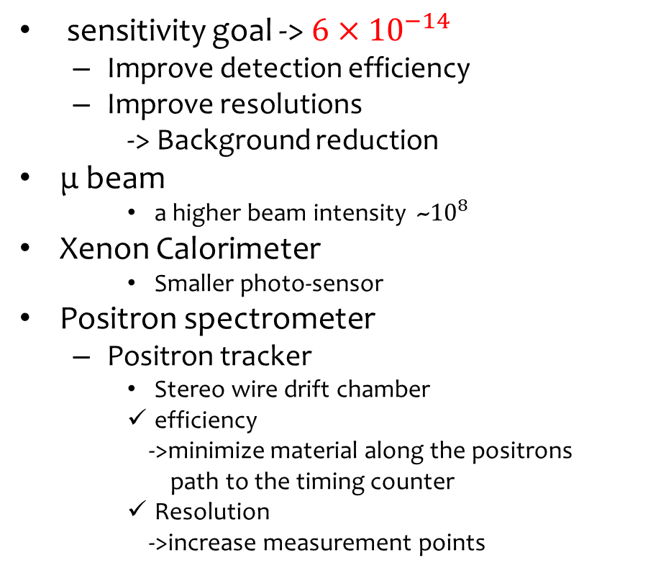
Upgrade
COBRA
sensitivity goal -> $6×{10}^{−14}$
  Improve detection efficiency
  Improve resolutions
  -> Background reduction
μ beam
    a higher beam intensity ~${10}^{8}$
Xenon Calorimeter
    Smaller photo-sensor
Positron spectrometer
  Positron tracker
    Stereo wire drift chamber
    efficiency
    ->minimize material along the positrons
    path to the timing counter
    Resolution
    ->increase measurement points
present
DC
TC
upgrade
    - Timing counter
    Pixelated Timing Counter
(detail of MEG upgrade; arXiv:1301.7225)

Slide 6
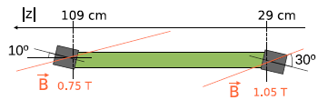
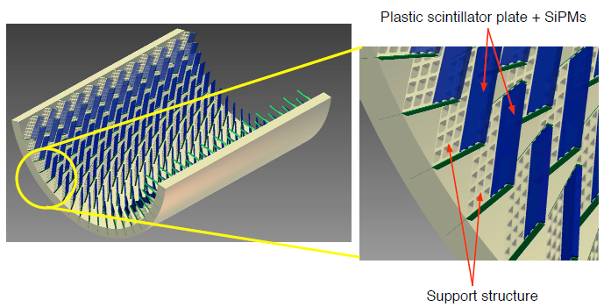
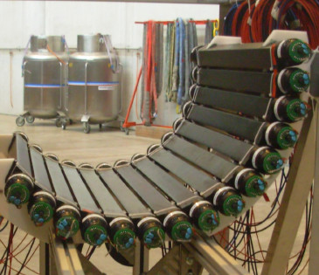
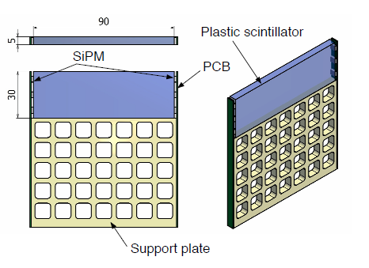

Pixelated Timing Counter
Scintillator
~90cm
~30cm
PMT
~300 pixels $×2$ (upstream, downstream side)
present
upgrade
Composed of several hundreds of small scintillator plates with SiPM readout
  A good timing resolution of single pixel
  Using multiple hit time
  Less pileup
  Flexible detector layout
  Additional track information
  Insensitivity to magnetic field
  Operational in helium gas
-> Readout by waveform digitizer (DRS developed at PSI)
Notes:
Presentの写真にdimension

Slide 7
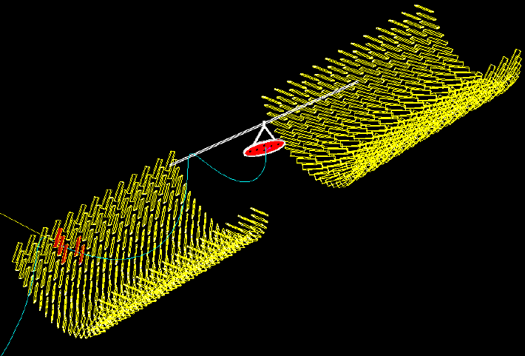
Multi-counter hit
MC simulation
Signal positron
5-counter hit

Slide 8
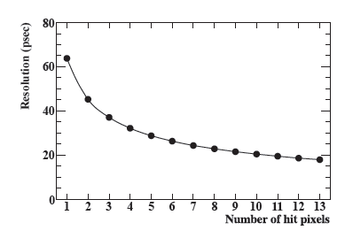
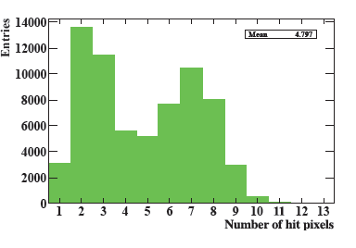
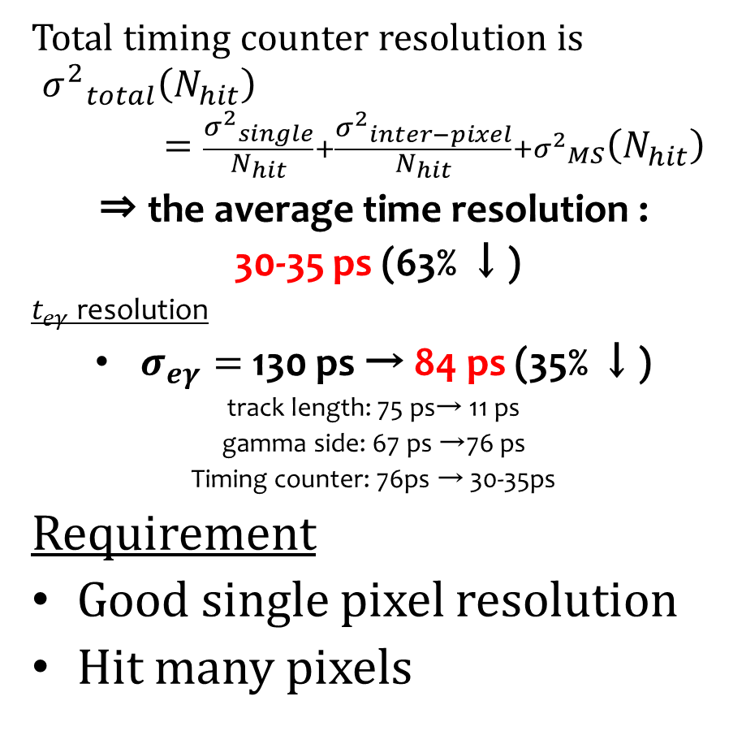
Multiple hit scheme
Total timing counter resolution is
$${σ^{2}}_{total}^{}\left(N_{hit}\right)=\frac{{σ^{2}}_{single}^{}}{N_{hit}}+\frac{{σ^{2}}_{inter−pixel}^{}}{N_{hit}}+{σ^{2}}_{MS}^{}\left(N_{hit}\right)$$
⇒ the average time resolution :
30-35 ps (63% ↓)
$t_{eγ}$ resolution
$σ_{eγ}=$130 ps → 84 ps (35% ↓)
track length: 75 ps→ 11 ps
gamma side: 67 ps →76 ps
Timing counter: 76ps → 30-35ps
Requirement
Good single pixel resolution
Hit many pixels
30-40 ps
~5ps
Notes:
Background 35%減らせる、trackerのためにも作り直さないといけない。

Slide 9
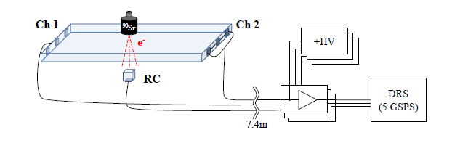
Single Pixel Study
Test Counter
  HAMAMATSU MPPC (S10362-33-050C)
    3x3 mm2, 50mm-3600 pixels
  glued with optical grease (OKEN6262A)
Source Sr90 (<2.28MeV, β-ray)
Reference counter
  5×5×5 mm
  Readout by a MPPC
  Trigger, Collimate
Waveform digitizer sampling (DRS developed at PSI) @5GSPS
Voltage amplifier developed by PSI (Gain~20, 600 MHz bandwidth)
Shaping with high-pass filter & pole-zero cancellation
Long cable before amplifier
KEITHLEY Pico ammeter for MPPC bias (HV), Bias 218V~222V (for series connection)
3 or 4 MPPCs
Series connection

Slide 10
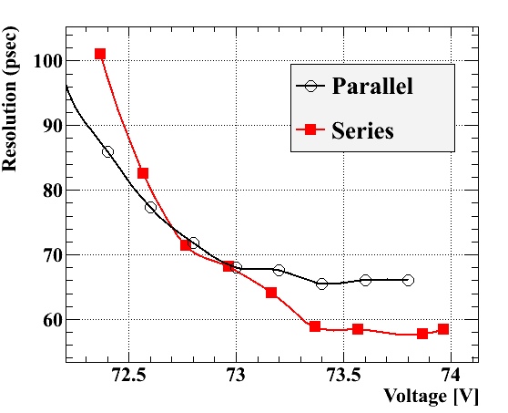
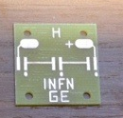
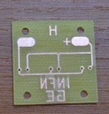
Series vs. parallel connection
Parallel
  We can’t apply bias voltage to each MPPC. We should choose MPPCs which have the same characteristic.
  Capacitance ↑
  -> waveform wider
Series
  Automatically bias voltage is adjusted.
  Waveform is sharper.
Series connection gives us better results.

Slide 11
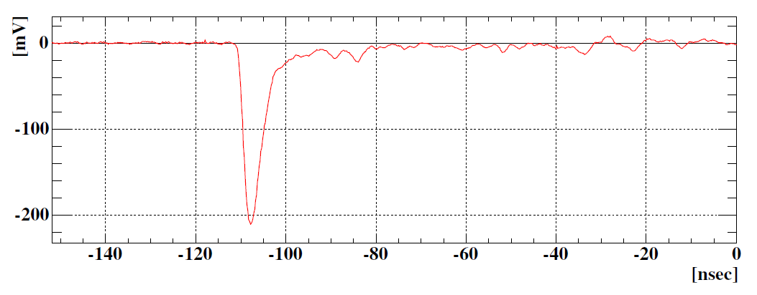
Analysis
Signal time is picked-off by Constant-Fraction method (~10%)
  very leading-edge is relevant to precise timing
e hit time is reconstructed by the average of times measured at the both ends
Resolution of test counter is evaluated from (t₁ + t₂)/2 – t_{ref}
baseline restoration by the
pole-zero cancellation @ preamp
t_{rise}~1.7 ns

Slide 12
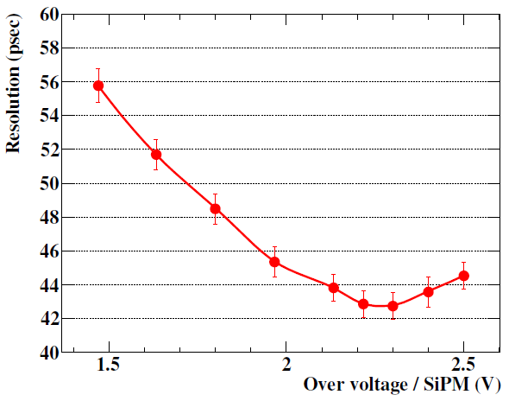
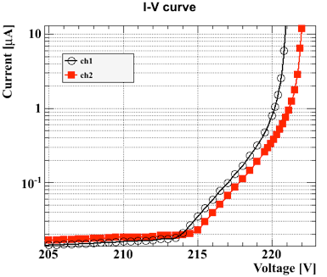
Bias dependence
BC422
6x3x0.5 cm³
3M mirror film
3 MPPCs
connected in series
operation
Break-down
voltage
Good time resolution of 43 ps is obtained.
Improvement in resolution as over-voltage
then degraded because of higher dark noise
Following test done at over-voltage =2.3V

Slide 13
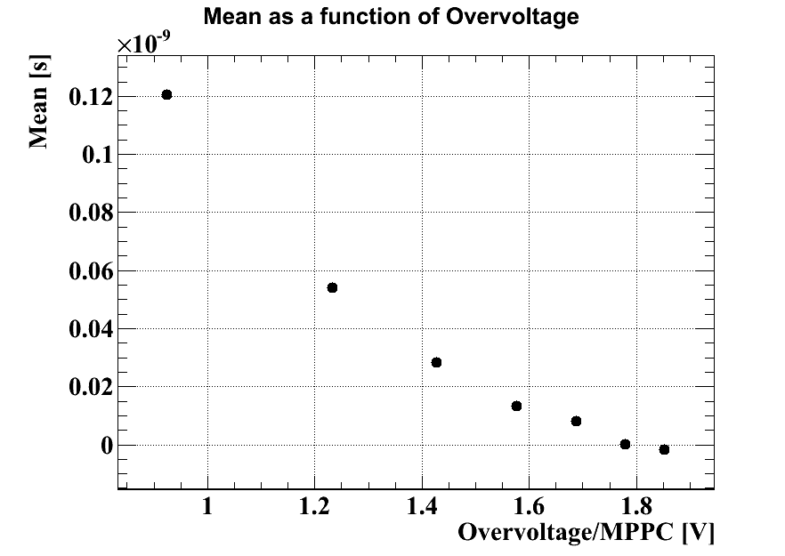
Temperature dependence
Relatively large temperature coeff. of break-down voltage for MPPC (56mV/℃) might be an issue
  Temp. variation in COBRA is a few ℃
  Time shift due to this is expected to be ~15 ps
    doesn’t seem a big issue
  Possible solutions
    Improve detector
    temp. stabilization
    KETEK SiPM with
    lower temp. coeff.
    (<1%/℃)
Measured time shift vs over voltage
~100ps/V
Notes:
ＭＰＰＣは何パーセントか。

Slide 14
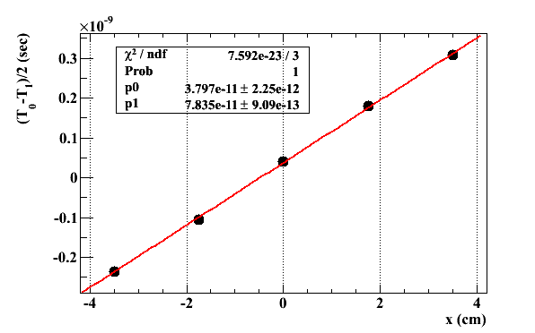
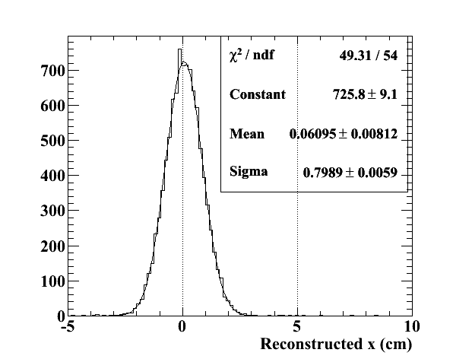






Position Reconstruction
$$x$$
Using position scanning data, positron hit position in a pixel can be reconstructed.
$$t_{0}$$
$$v$$
$$t_{1}$$
90x30x5 mm pixel measured point
$$x=v×\frac{t_{1}−t_{0}}{2}$$
Resolution
~ 8 mm
$x=v×\frac{t_{1}−t_{0}}{2}$ -> scintillation light speed

Slide 15
Optimization
Size
Scintillators
Manufacture of SiPM

Slide 16
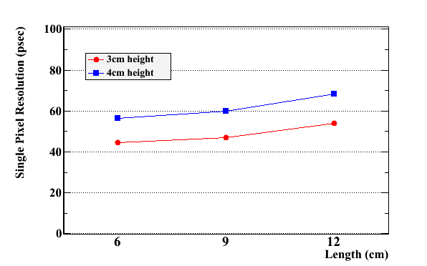
Size Optimization
3cm height
measured
MC
Single resolution is worse with larger pixel.
However # of hit pixel increases with larger pixels.

Slide 17
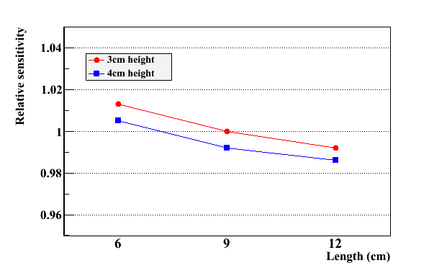
Result of size optimization
better
MC
Larger pixel is better.
(Effect of high rate is not included.)

Slide 18
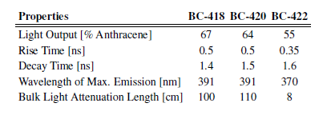
Scintillator Type
Test BC418, 420, and 422 which is 90x40x5mm with 4MPPCs
Properties of ultra-fast plastic scintillators from Saint-Gobain
Scintillator Type | Single Resolution (ps)
BC422 | 51.2
BC420 | 57.7
BC418 | 55.8

Slide 19
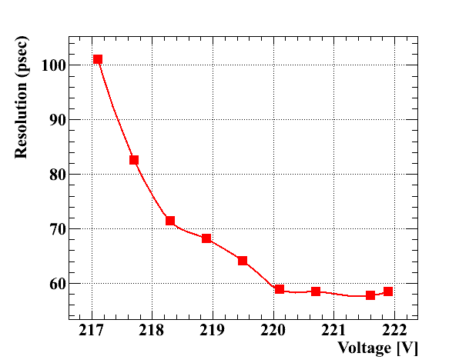
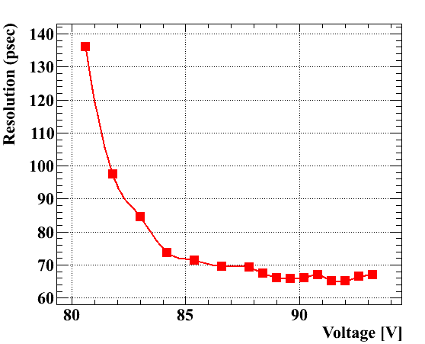
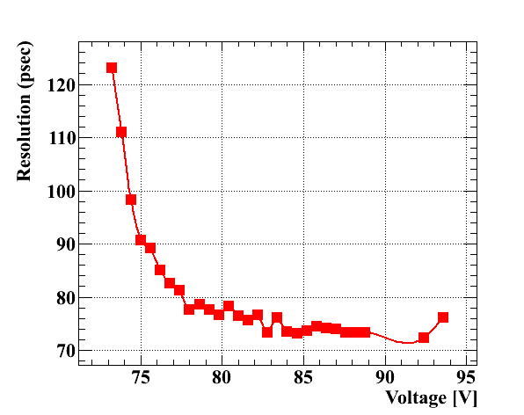
Manufacture of SiPM
(Preliminary)
HAMAMATSU
AdvanSiD
Best resolution ~ 58 ps
~ 65 ps
HAMAMATSU SiPMs give us the best resolution.
KETEK
~ 75 ps

Slide 20
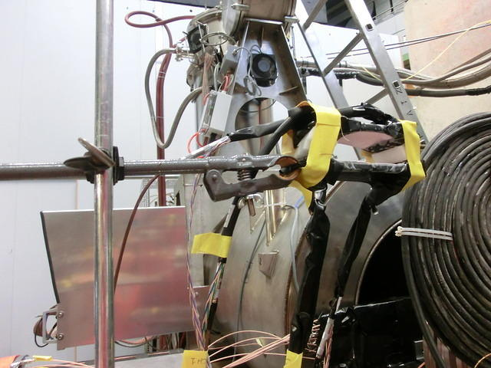
Beam test in PSI
Motivation
Check the noise in the area
Obtain data where the beam penetrates two counters
Check the response to MIP
Check if we can obtain consistent time resolution in the area
Pre-test for planned beam test with prototype detector.
Setup
Mu beam
Counter 1 (C1): BC422 60x30x5mm, 3M wrapping
Counter 2 (C2): BC422 90x30x5mm, 3M wrapping
Light tight shielding with black tape.
4 Pt100 at each MPPC’s board (data
logger)
Preamplifier
Stage, stands
HV modules
-> Expected resolution from lab data is
~33ps (C1 43.6 ps , C2 49.9 ps) no inter-counter jitter
4 cm
C1
C2
y
69 cm
z
positron
Beamline
degrader
Target
Collimator

Slide 21
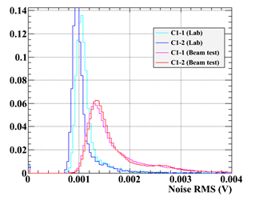
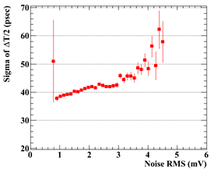
Noise
Lab
Beam test
Noise increased by ~40%.
Resolution depends on noise. (~ 2-3 ps/ mV)
-> Noise must be decreased.
Now PCB is being improved.

Slide 22
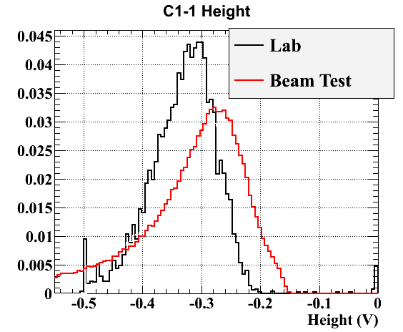
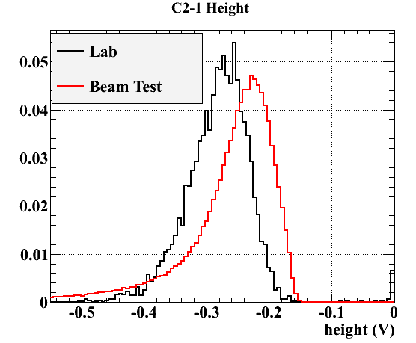
Result
Pulse height decreases by 13% (C1-1) and 21% (C2-1)
Expected decreasing is 10 – 20 %
(Lab: <2MeV beta from Sr90, Beam test: MIP)
C1
C2
4cm
0.5 cm
Without position cut, two counter resolution is 40 ps.
With position cut of 5mm width at the center, resolution is 35 ps.
-> Analysis at selected position gives the consistent resolution with lab data. (expected ~33ps)
We can obtain better resolution by multiple hits. (single ~ 50 ps)

Slide 23
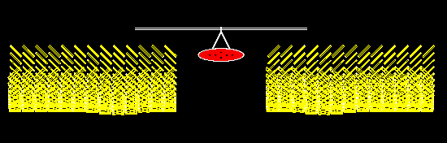
Summary and Prospects
summary
  Pixelated timing counter with an improved timing resolution is under development for MEG upgrade.
  About single counter, good time resolution of ~43 ps was obtained.
  Several optimization about single pixel was done.
    Size, scintillator, SiPM
  Beam test
    Though noise increase good resolution can be obtained.
    By multiple hit, better resolution can be obtained.
prospects
  decide the pixel layout
  construct the prototype detector with several tens of pixels in next spring and summer.
    Beam test
    Prove multiple hit scheme

