Slide 1
Investigation of Strangeness Photo-Production near the Threshold
Masashi Kaneta
for the NKS2 collaboration
Department of Physics, Tohoku University

Slide 2
Questions

Slide 3
Q. 1
You are:
(1) an under graduate student,
(2) a master course student,
(3) a doctor course student, or
(4) not a student

Slide 4
Q. 2
Have you ever taken
a class of nuclear physics?

Slide 5
Q. 3
Do you think that
QCD can calculate
everything of hadron?

Slide 6
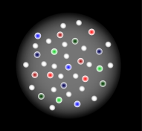
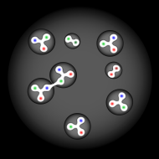
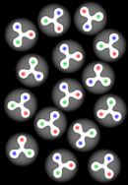
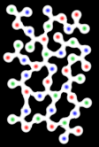
QCD Phase Diagram
Big bang
Stars
Neutron Star
Quark Star
Quark-Gluon Plasma
(QGP) phase
phase
transition
Temperature
cooling
compression
phase transition
Hadron Phase
Baryon
Meson
Color
superconductivity?
Neutron Star
element synthesis
0
Our world
Baryon density

Slide 7
Accelerators and Facilities
Big bang
Stars
Neutron Star
Quark Star
Quark-Gluon Plasma
(QGP) phase
RCNP
Osaka U.
FAIR
GSI
phase
transition
LHC
CERN
RIBF
RIKEN
LHC
CERN
RHIC
BNL
J-PARC
Temperature
SPS
CERN
cooling
SIS 200/300
GSI
compression
phase transition
AGS
BNL
Beam
Ion
Hadron
Photon
Hadron Phase
SIS
GSI
J-PARC
JLab
AGS
Baryon
Meson
Spring-8
ELPH
Tohoku U.
Color
superconductivity?
Neutron Star
element synthesis
0
Our world
Baryon density

Slide 8
My Phase Shift (Transition?)
Big bang
Stars
Neutron Star
Quark Star
Quark-Gluon Plasma
(QGP) phase
1994-1999
Graduate student
of Hiroshima Univ.
phase
transition
LHC
CERN
Temperature
SPS
CERN
cooling
compression
phase transition
Hadron Phase
Baryon
Meson
Color
superconductivity?
Neutron Star
element synthesis
0
Our world
Baryon density

Slide 9
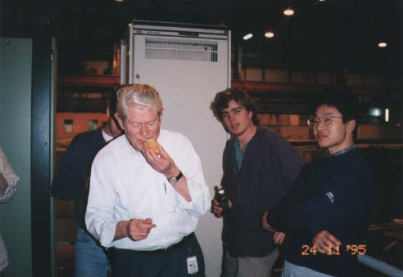
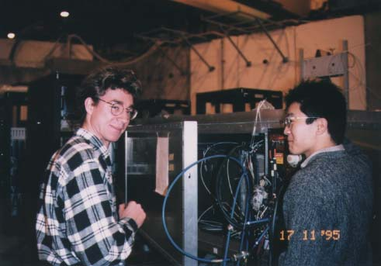
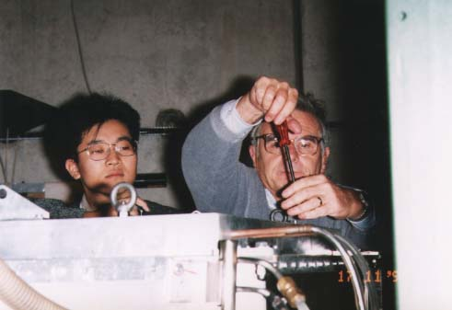
Pictures of NA44 Era

Slide 10
My Phase Shift (Transition?)
Big bang
1999-2005
PostDoc of LBNL and
RIKEN-BNL Research Center
Stars
Neutron Star
Quark Star
Quark-Gluon Plasma
(QGP) phase
phase
transition
LHC
CERN
RHIC
BNL
Temperature
SPS
CERN
cooling
compression
phase transition
Hadron Phase
Baryon
Meson
ELPH
Tohoku U.
Color
superconductivity?
Neutron Star
element synthesis
0
Our world
Baryon density

Slide 11
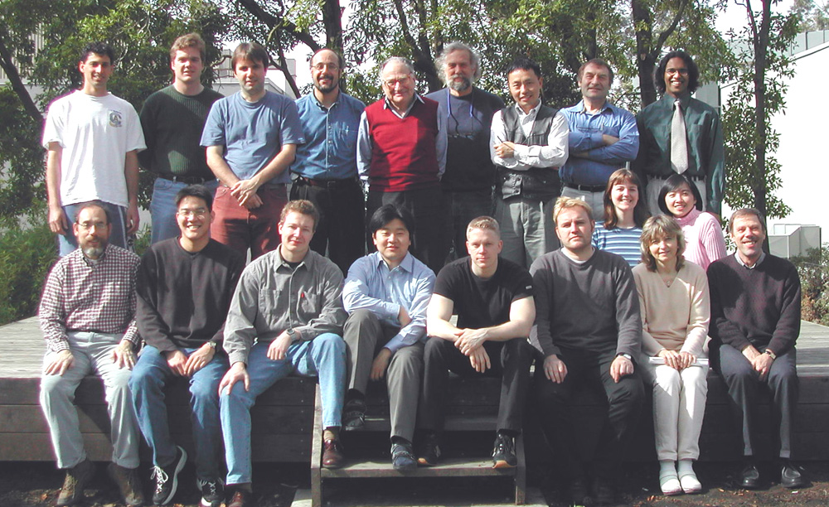
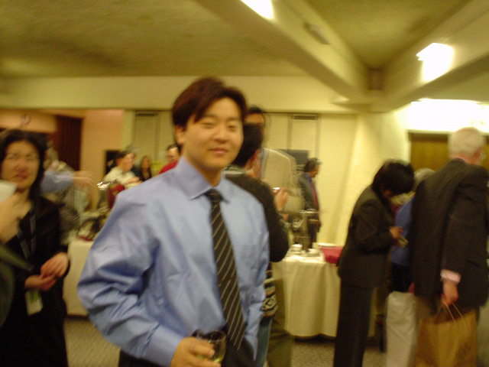
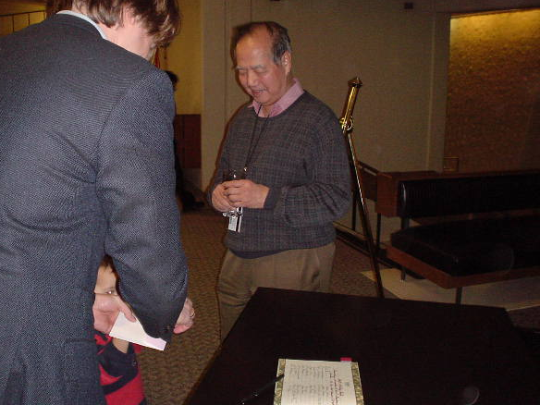
2002,
RNC Group,
LBNL
2004,
RBRC
Chirstman
Party
hosted by
T.D. Lee

Slide 12
My Phase Shift (Transition?)
Big bang
Stars
Neutron Star
Quark Star
Quark-Gluon Plasma
(QGP) phase
phase
transition
LHC
CERN
RHIC
BNL
Temperature
SPS
CERN
cooling
compression
phase transition
Hadron Phase
JLab
Baryon
Meson
ELPH
Tohoku U.
Color
superconductivity?
2005-Present
Assistant Prof.
of Tohoku Univ.
Neutron Star
element synthesis
0
Our world
Baryon density

Slide 13
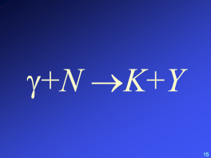
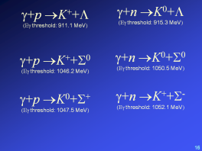
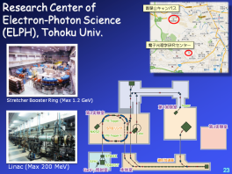
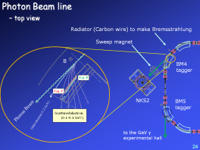
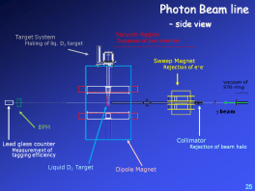
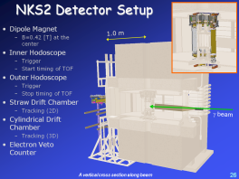
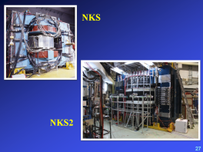
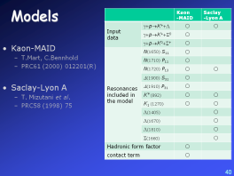
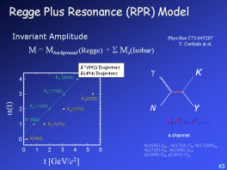
Outlook of This Talk

Slide 14
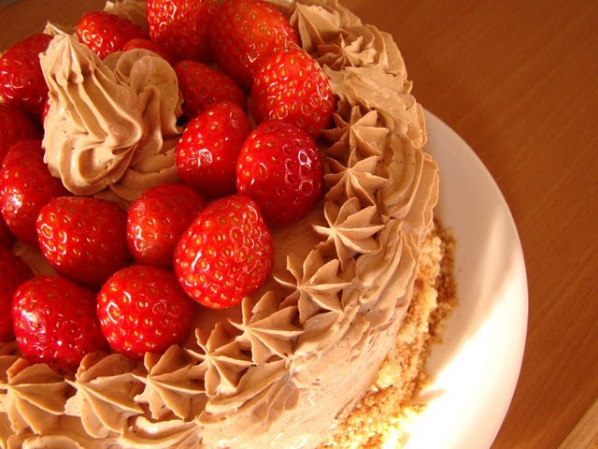
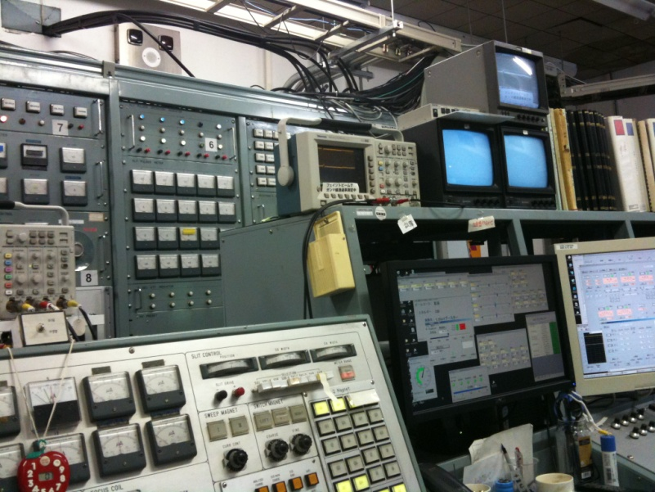
Introduction
序

Slide 15
Strangeness Photo-production
General aim
Understanding the mechanism of strangeness production
Reaction
hadron-hadron
gamma-nucleaon
Missing resonance search w/ energy scan
Characteristics of our experiment
Neutral channel
K ⁺ data is not enough to make a model to predict cross section of neutral channel
K ⁰ data is the KEY of the study
Threshold region
No resonance decay effect in the final products
Notes:
Threshold の値をメモしておく

Slide 16
γ+N →K+Y

Slide 17
γ+p →K⁺+Λ
(Εγ threshold: 911.1 MeV)
γ+p →K⁺+Σ⁰
(Εγ threshold: 1046.2 MeV)
γ+p →K⁰+Σ⁺
(Εγ threshold: 1047.5 MeV)
γ+n →K⁰+Λ
(Εγ threshold: 915.3 MeV)
γ+n →K⁰+Σ⁰
(Εγ threshold: 1050.5 MeV)
γ+n →K⁺+Σ⁻
(Εγ threshold: 1052.1 MeV)

Slide 18
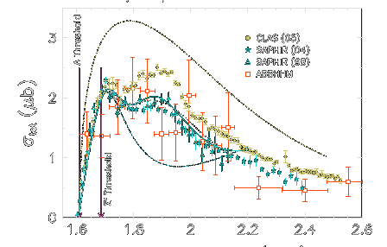
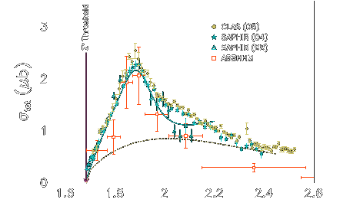
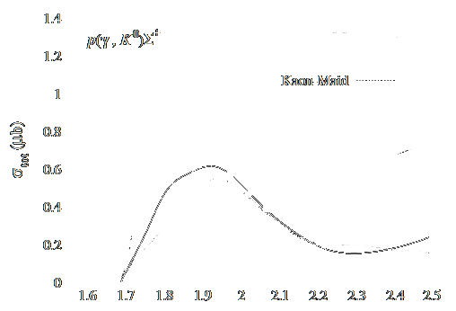
Data in the Market
γ+p→K⁺+Λ
Phys.Rev.C73(2006)035202
γ+n→K⁰+Λ
NKS experiment:
differencial cross section
in Eγ=0.8-1.1 GeV
PRC78(2008)014001
γ+p→K⁺+Σ⁰
Phys.Rev.C73(2006)035202
γ+n→K⁰+Σ⁰
γ+n→K⁺+Σ⁻
LEPS experiment:
differencial cross section in Eγ=1.5-2.4 GeV
with polarized photon beam
PRL97 (2006)082003
γ+p→K⁰+Σ⁺
SAPHIR
Phys.Lett.B464(1999)331
CLAS experiment:
differencial cross section in Eγ=1.1-3.6 GeV
PLB688(2010)289

Slide 19
Experiments to investigate
Strangeness Photo-Production
at LNS/ELPH, Tohoku Univ.
NKS
and
NKS2

Slide 20
Experiments to investigate
Strangeness Photo-Production
at LNS/ELPH, Tohoku Univ.
NKS
Neutral Kaon Spectrometer
2000-2004:
Using TAGX spectrometer
Reconstruct K⁰_{S} from π⁺π⁻ decay
The first measurement of K⁰ cross section
from γ+n→K⁰+Λ reaction [Phys.Rev.C78(2008)014001]

Slide 21
Experiments to investigate
Strangeness Photo-Production
at LNS/ELPH, Tohoku Univ.
2005
Construction of new spectrometer
2006-2007
Data taking
2008-2009
Upgrade inner detectors
2010
Data taking
NKS2

Slide 22
The NKS2 Collaboration
Department of Physics, Tohoku University
B. Beckford, T. Fujii, Y. Fujii, T.Fujibayashi, K. Futatsukawa,
O. Hashimoto, A. Iguchi, H. Kanda, Kaneko, M. Kaneta,
T. Kawasaki, C. Kimura, S. Kiyokawa, T. Koike, K. Maeda,
N. Maruyama, Matsubara, Y. Miyagi, K. Miwa, S.N. Nakamura,
A. Okuyama, H. Tamura, K. Tsukada, N. Terada, F. Yamamoto
Research Center of Electron-Photon Science, Tohoku University
K. Hirose, T. Ishikawa, T. Tamae, H. Yamazaki
Department of Nuclear Science, Lanzhou University, Lanzhou, China
Y.C. Han, T.S. Wang
Nuclear Institute, Czech Republic
P. Bydzovsky, M. Sotona
博士課程前期 (修士で卒業)
博士課程後期 (Dr.Sc.を所得)

Slide 23
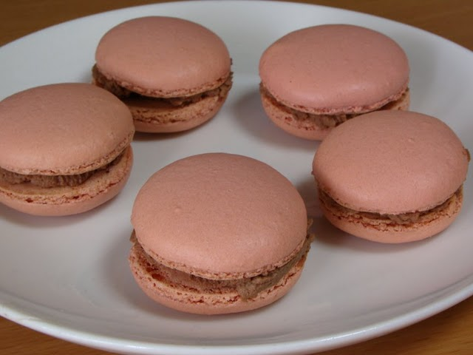
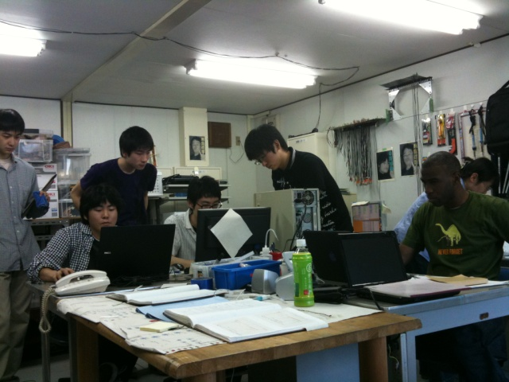
Experiment
実験

Slide 24
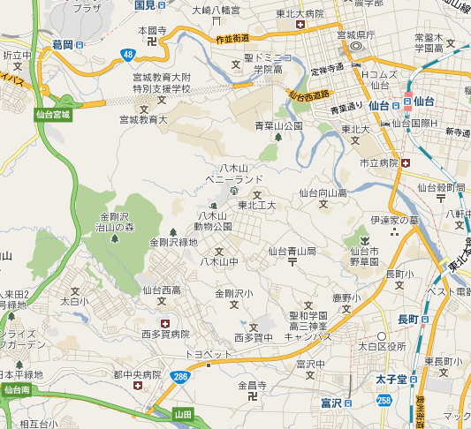
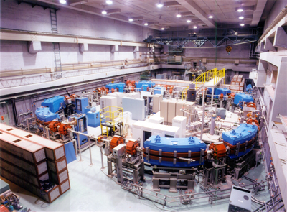
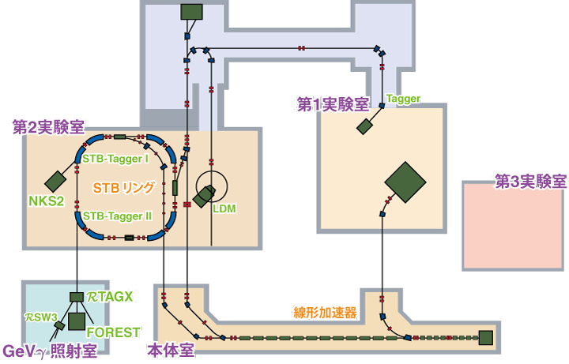
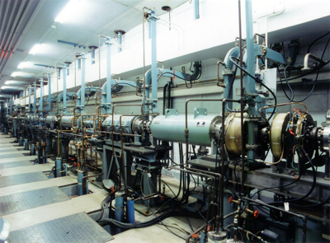
Research Center of Electron-Photon Science (ELPH), Tohoku Univ.
青葉山キャンパス
電子光理学研究センター
Stretcher Booster Ring (Max 1.2 GeV)
Linac (Max 200 MeV)
24

Slide 25
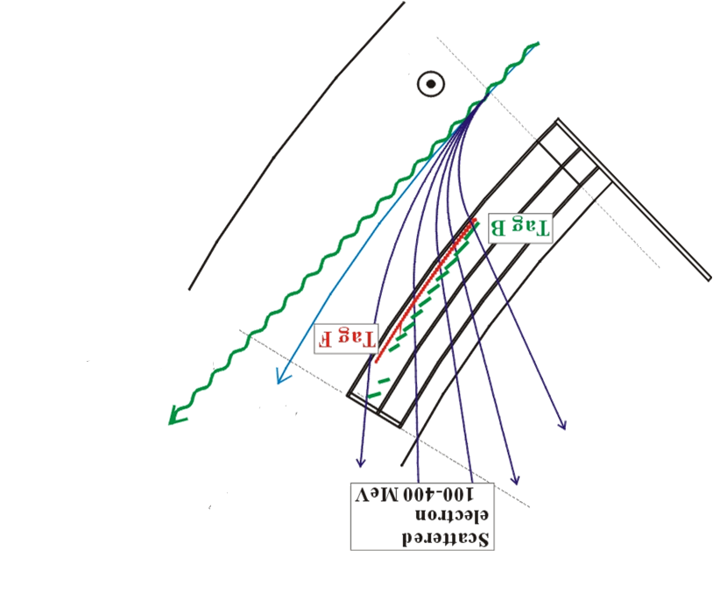
Photon Beam line
– top view
Radiator (Carbon wire) to make Bremsstrahlung
Sweep magnet
B
BM4
tagger
Tag B
Tag F
NKS2
BM5
tagger
Photon Beam
Scattered electron
(0.1-0.4 GeV)
Orbit electron (1.2 GeV)
to the GeV γ
experimental hall

Slide 26
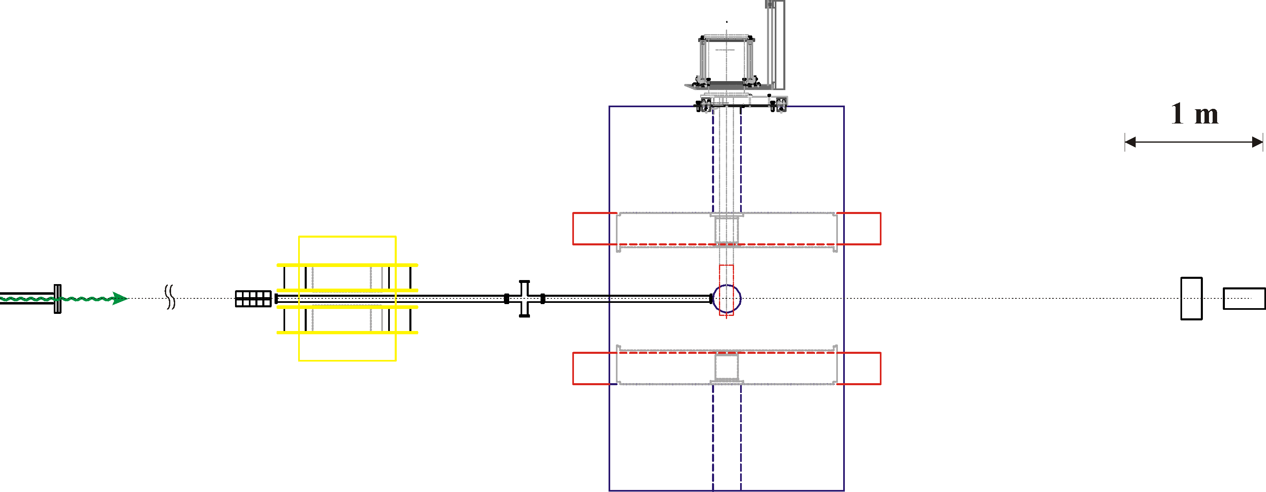
Photon Beam line
– side view
Target System
Making of liq. D₂ target
Vacuum Region
Suppress of pair creation
Sweep Magnet
Rejection of e⁺e⁻
vacuum of
STB-ring
γ beam
BPM
Lead glass counter
Measurement of tagging efficiency
Collimator
Rejection of beam halo
Liquid D₂ Target
Dipole Magnet

Slide 27
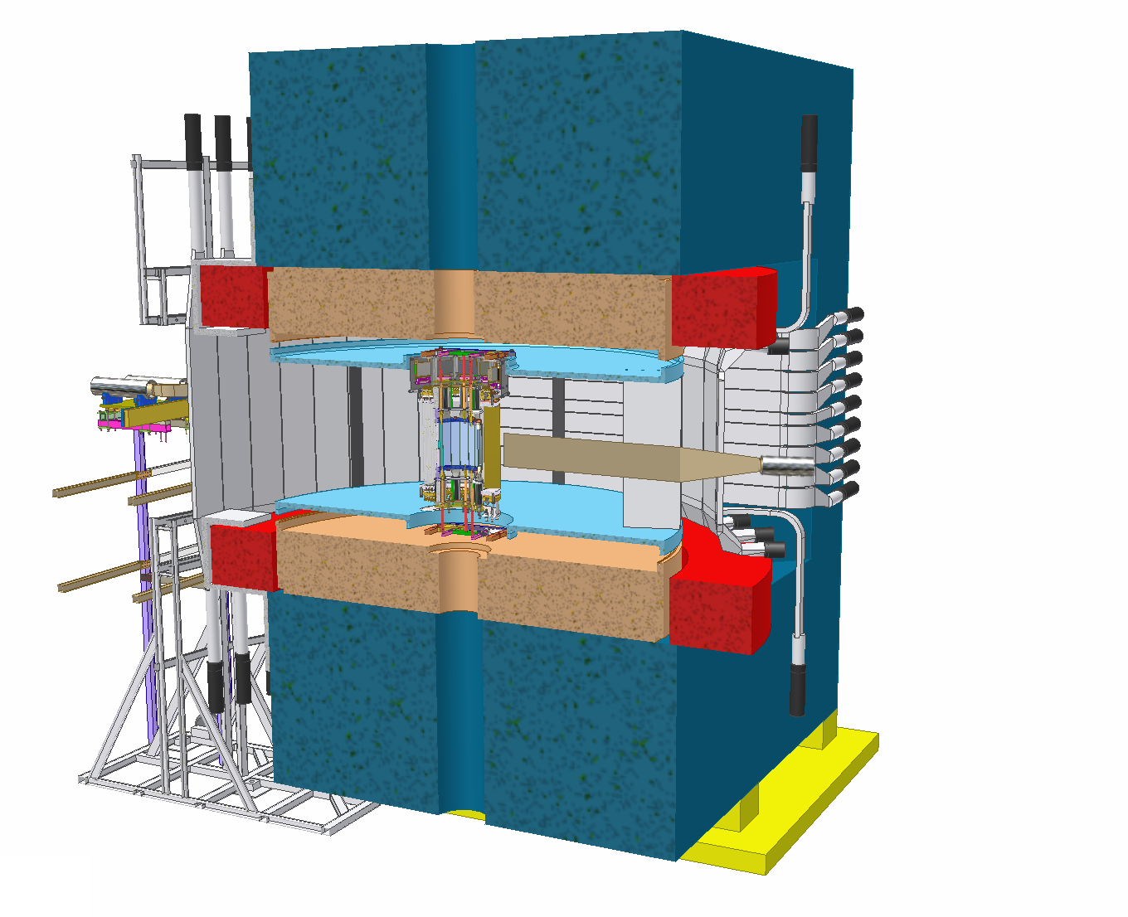
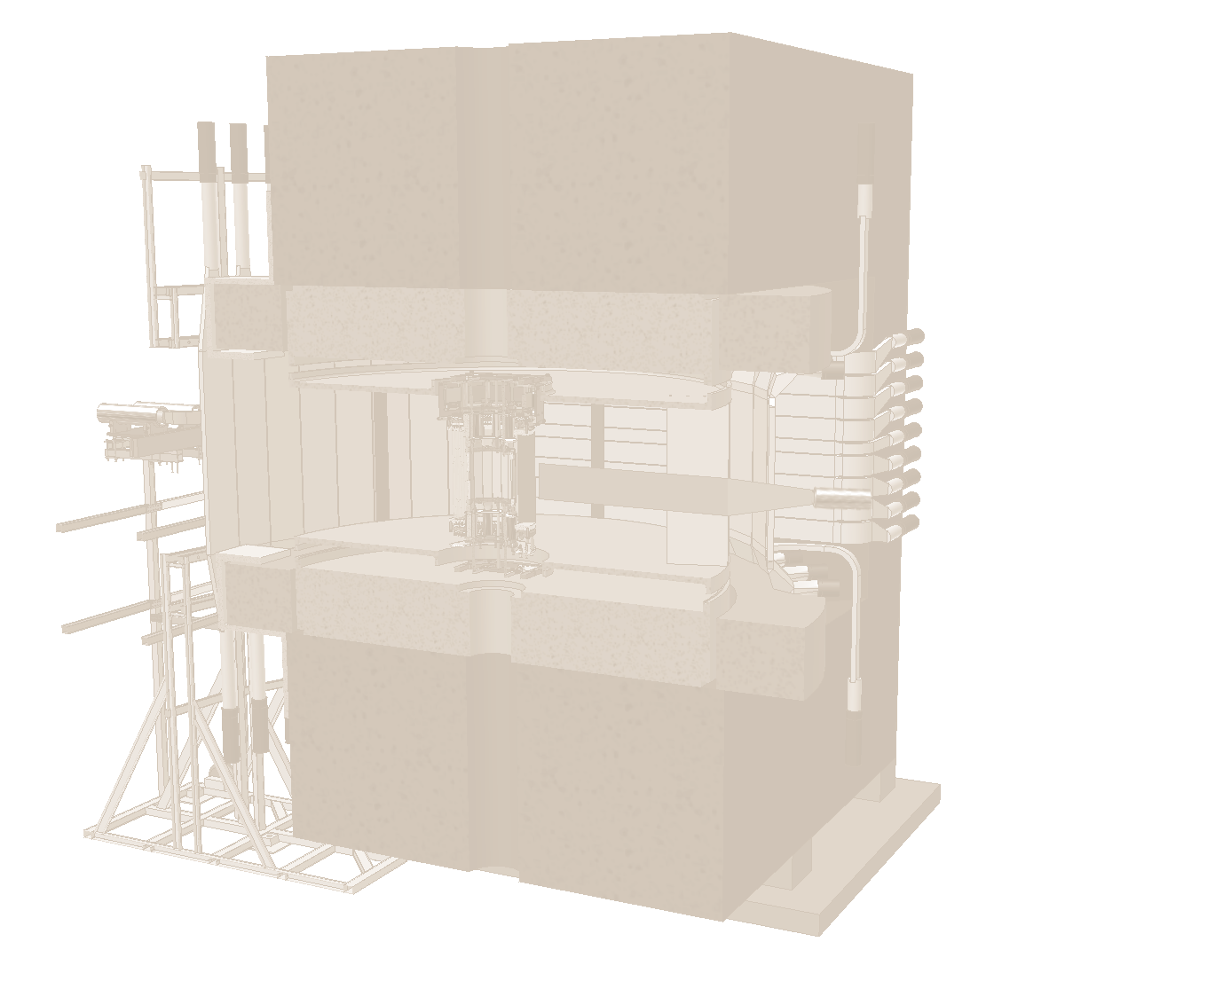
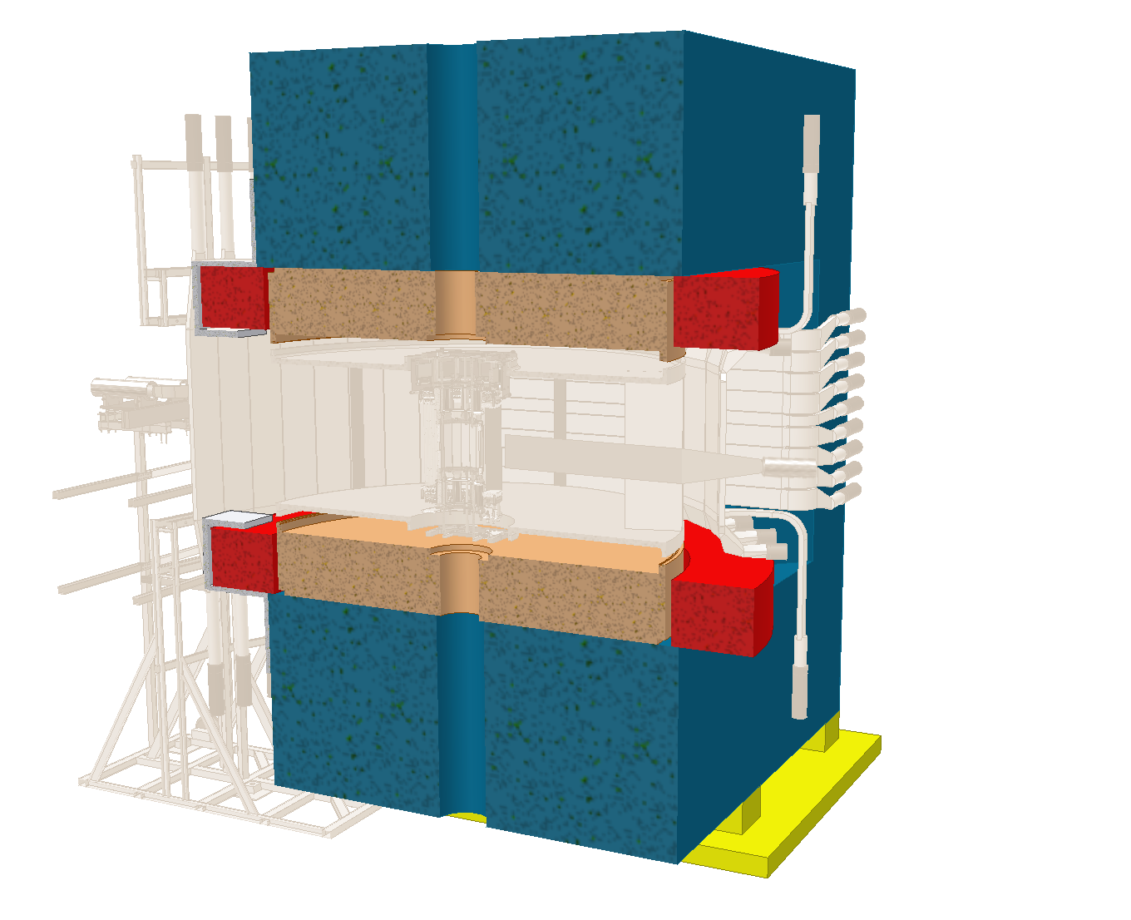
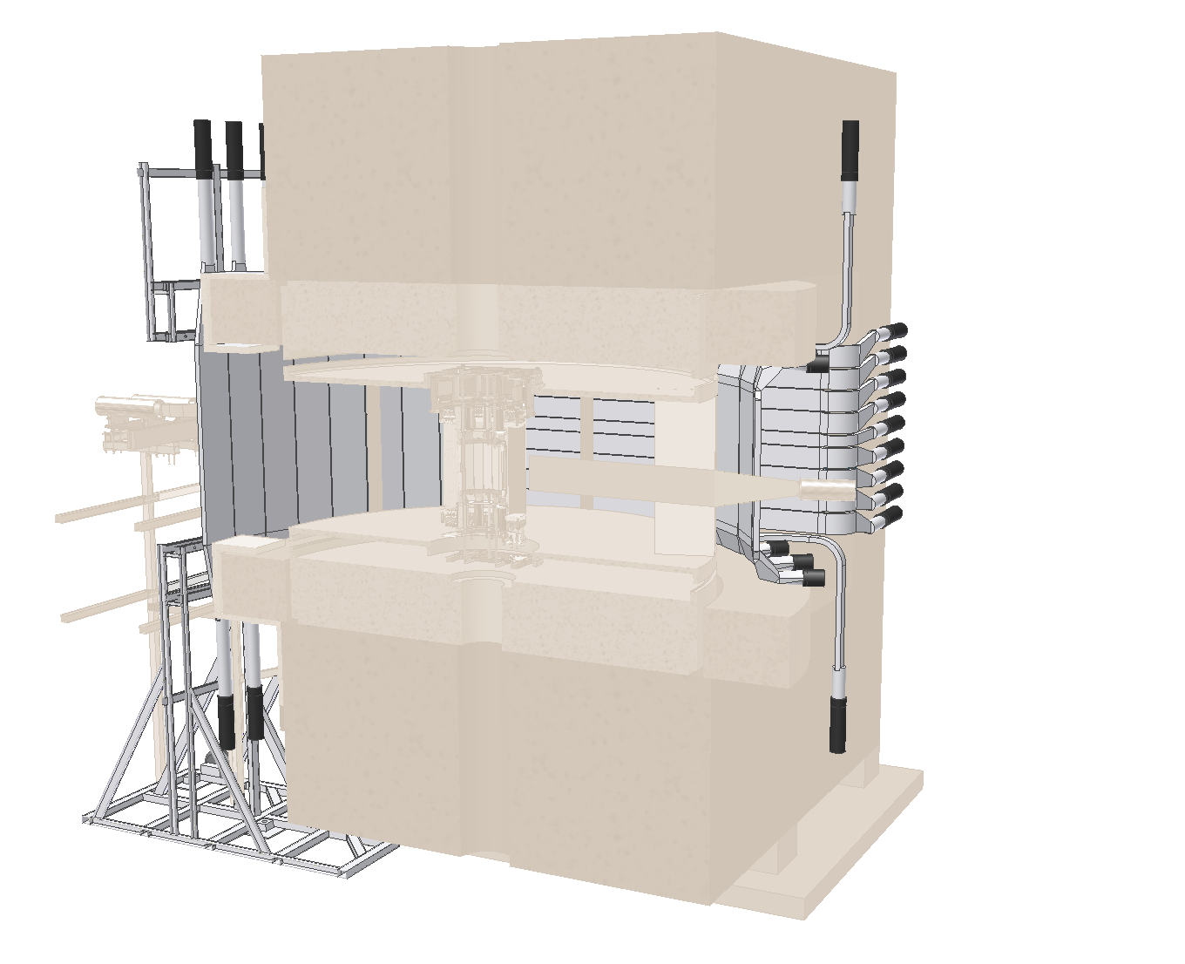
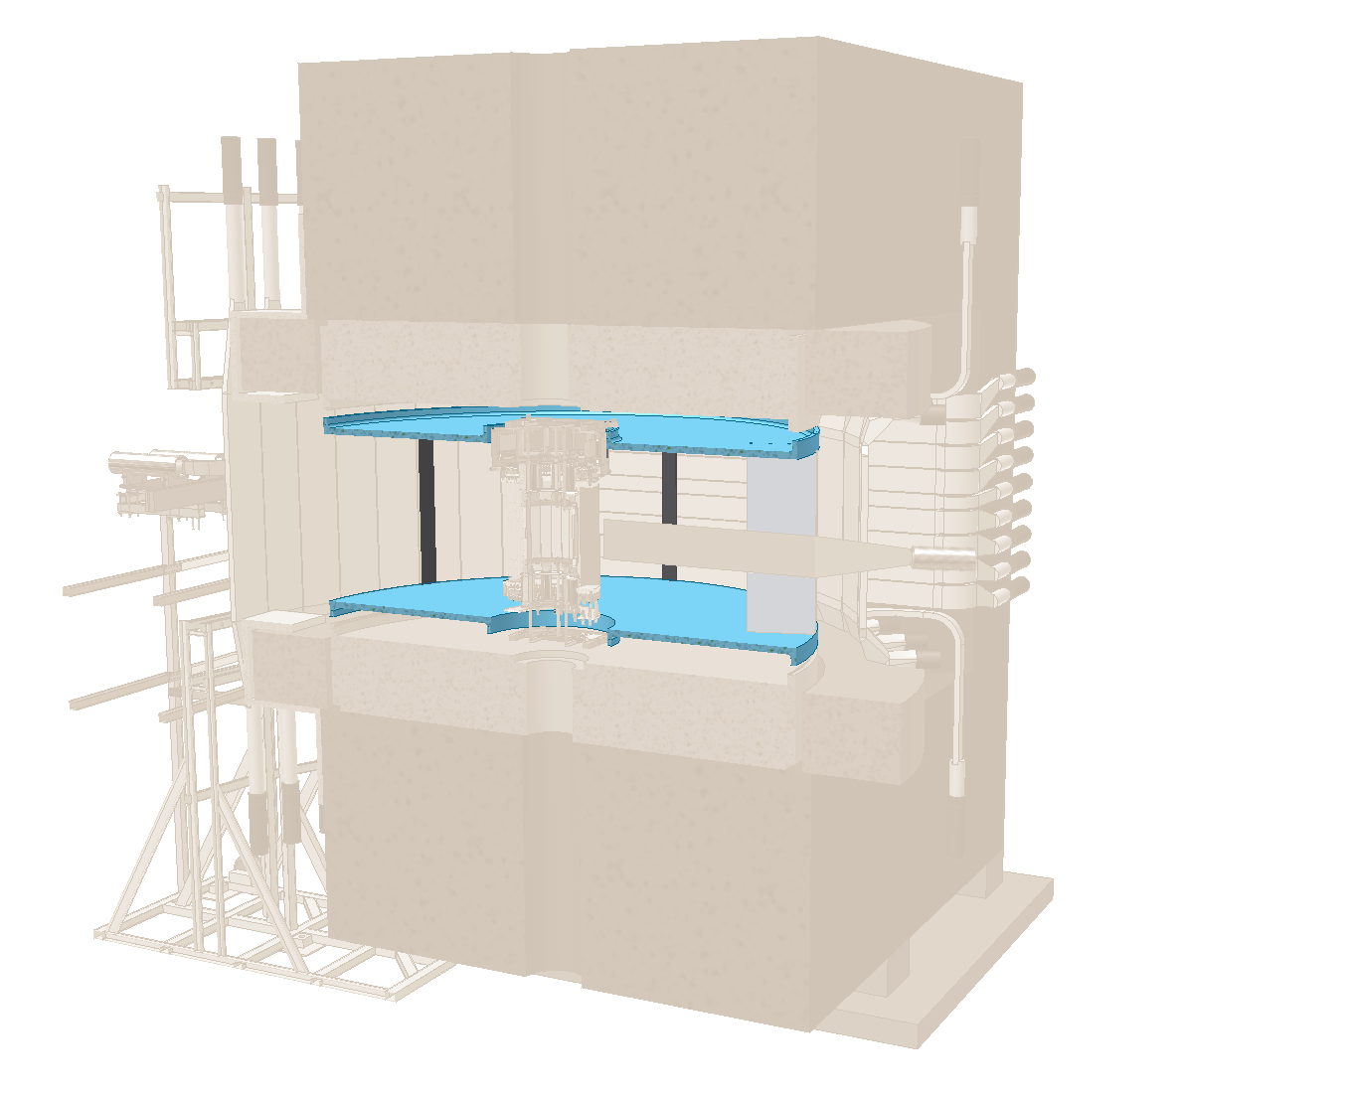
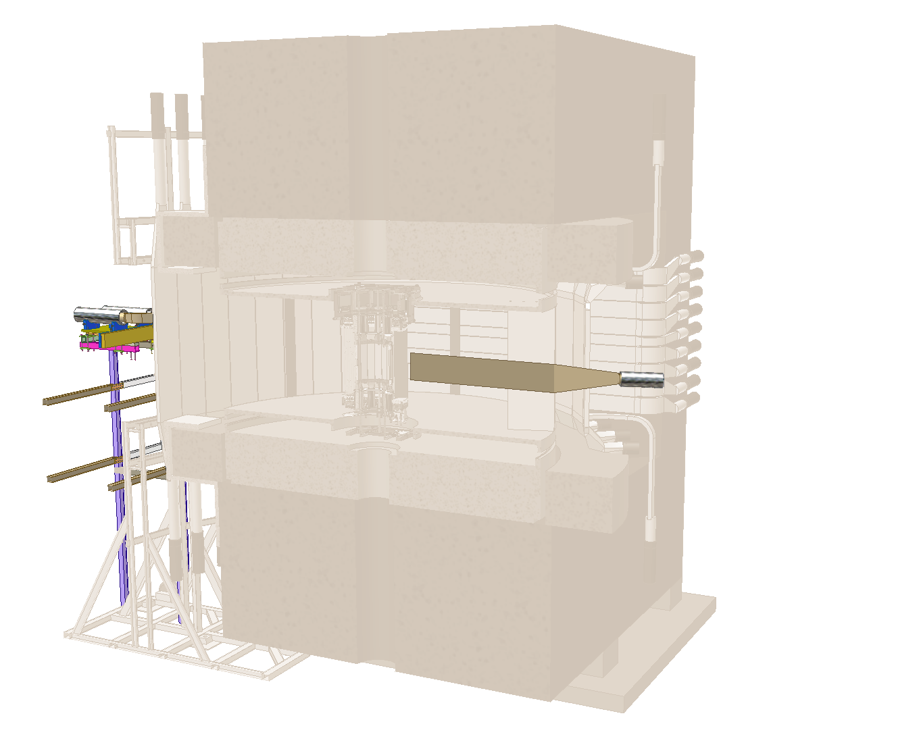
NKS2 Detector Setup
Dipole Magnet
B=0.42 [T] at the center
Inner Hodoscope
Trigger
Start timing of TOF
Outer Hodoscope
Trigger
Stop timing of TOF
Straw Drift Chamber
Tracking (2D)
Cylindrical Drift Chamber
Tracking (3D)
Electron Veto Counter
1.0 m
γ beam
A vertical cross section along beam

Slide 28
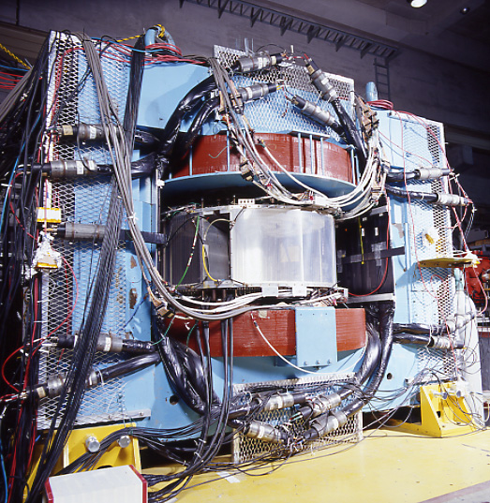
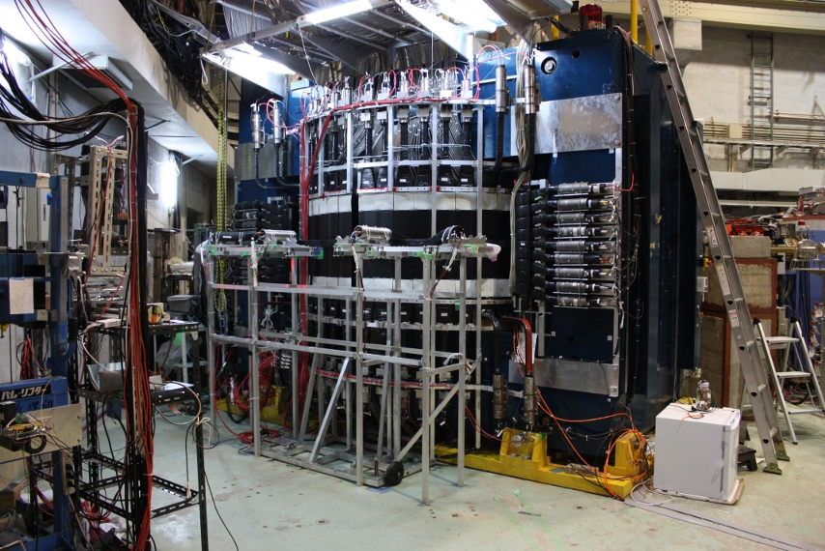
NKS
NKS2

Slide 29
Reaction
γ+d → K⁰+Λ+(p)
Decay Mode
K⁰_{S} → π⁺+π⁻
Λ → π⁻+p
Trigger
Photon: Tagger hit
2 charged particle: nHit on IH≥2 and nHit on OH≥2
Background rejection: Veto of e± from upstream
Trigger rate: ~1 kHz at 2 MHz tagger rate
DAQ efficiency ~70%

Slide 30
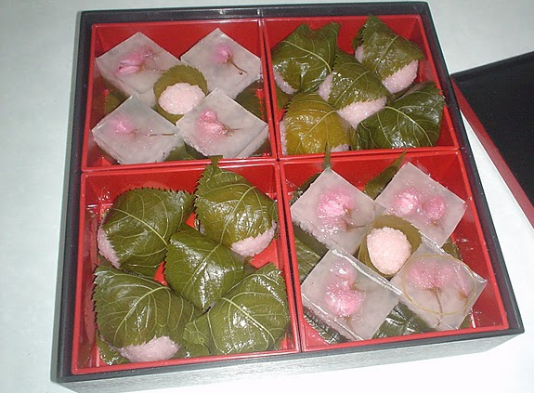
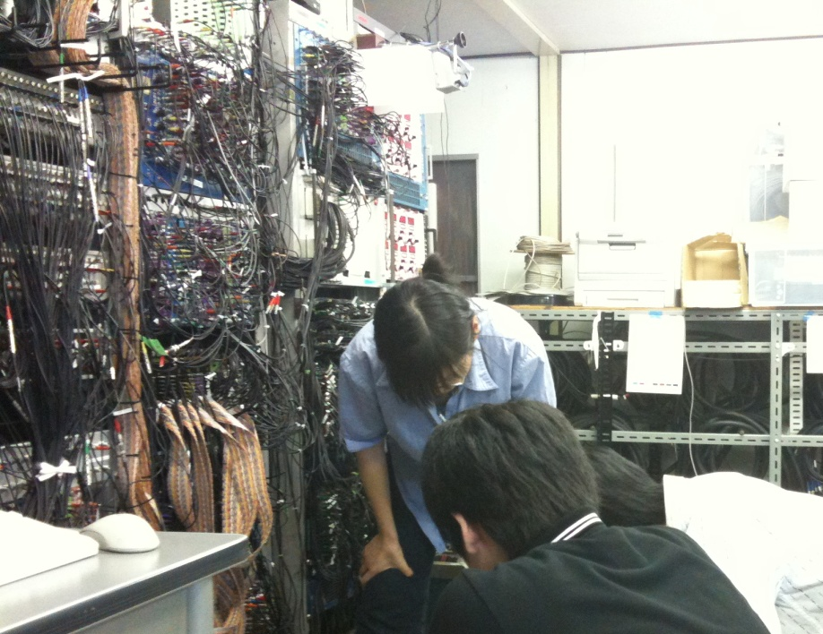
Recent Results
最近の結果

Slide 31
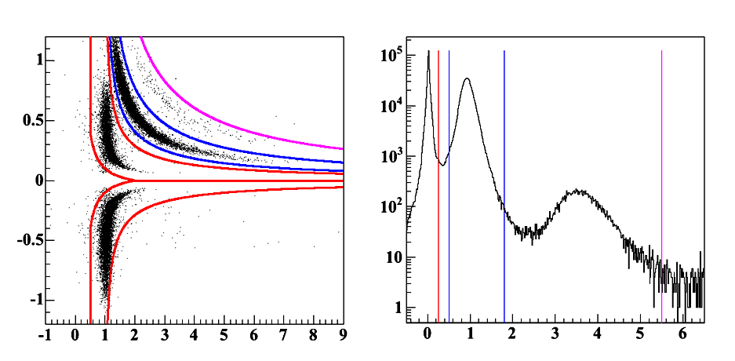
Particle Identification
p
π⁺
d
π⁺
charge×momentum [GeV/c]
p
π⁻
d
1/β
Mass square [GeV²/c⁴]

Slide 32
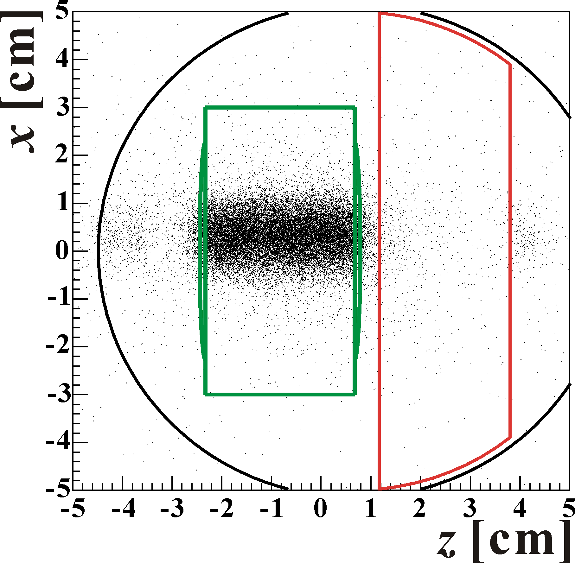
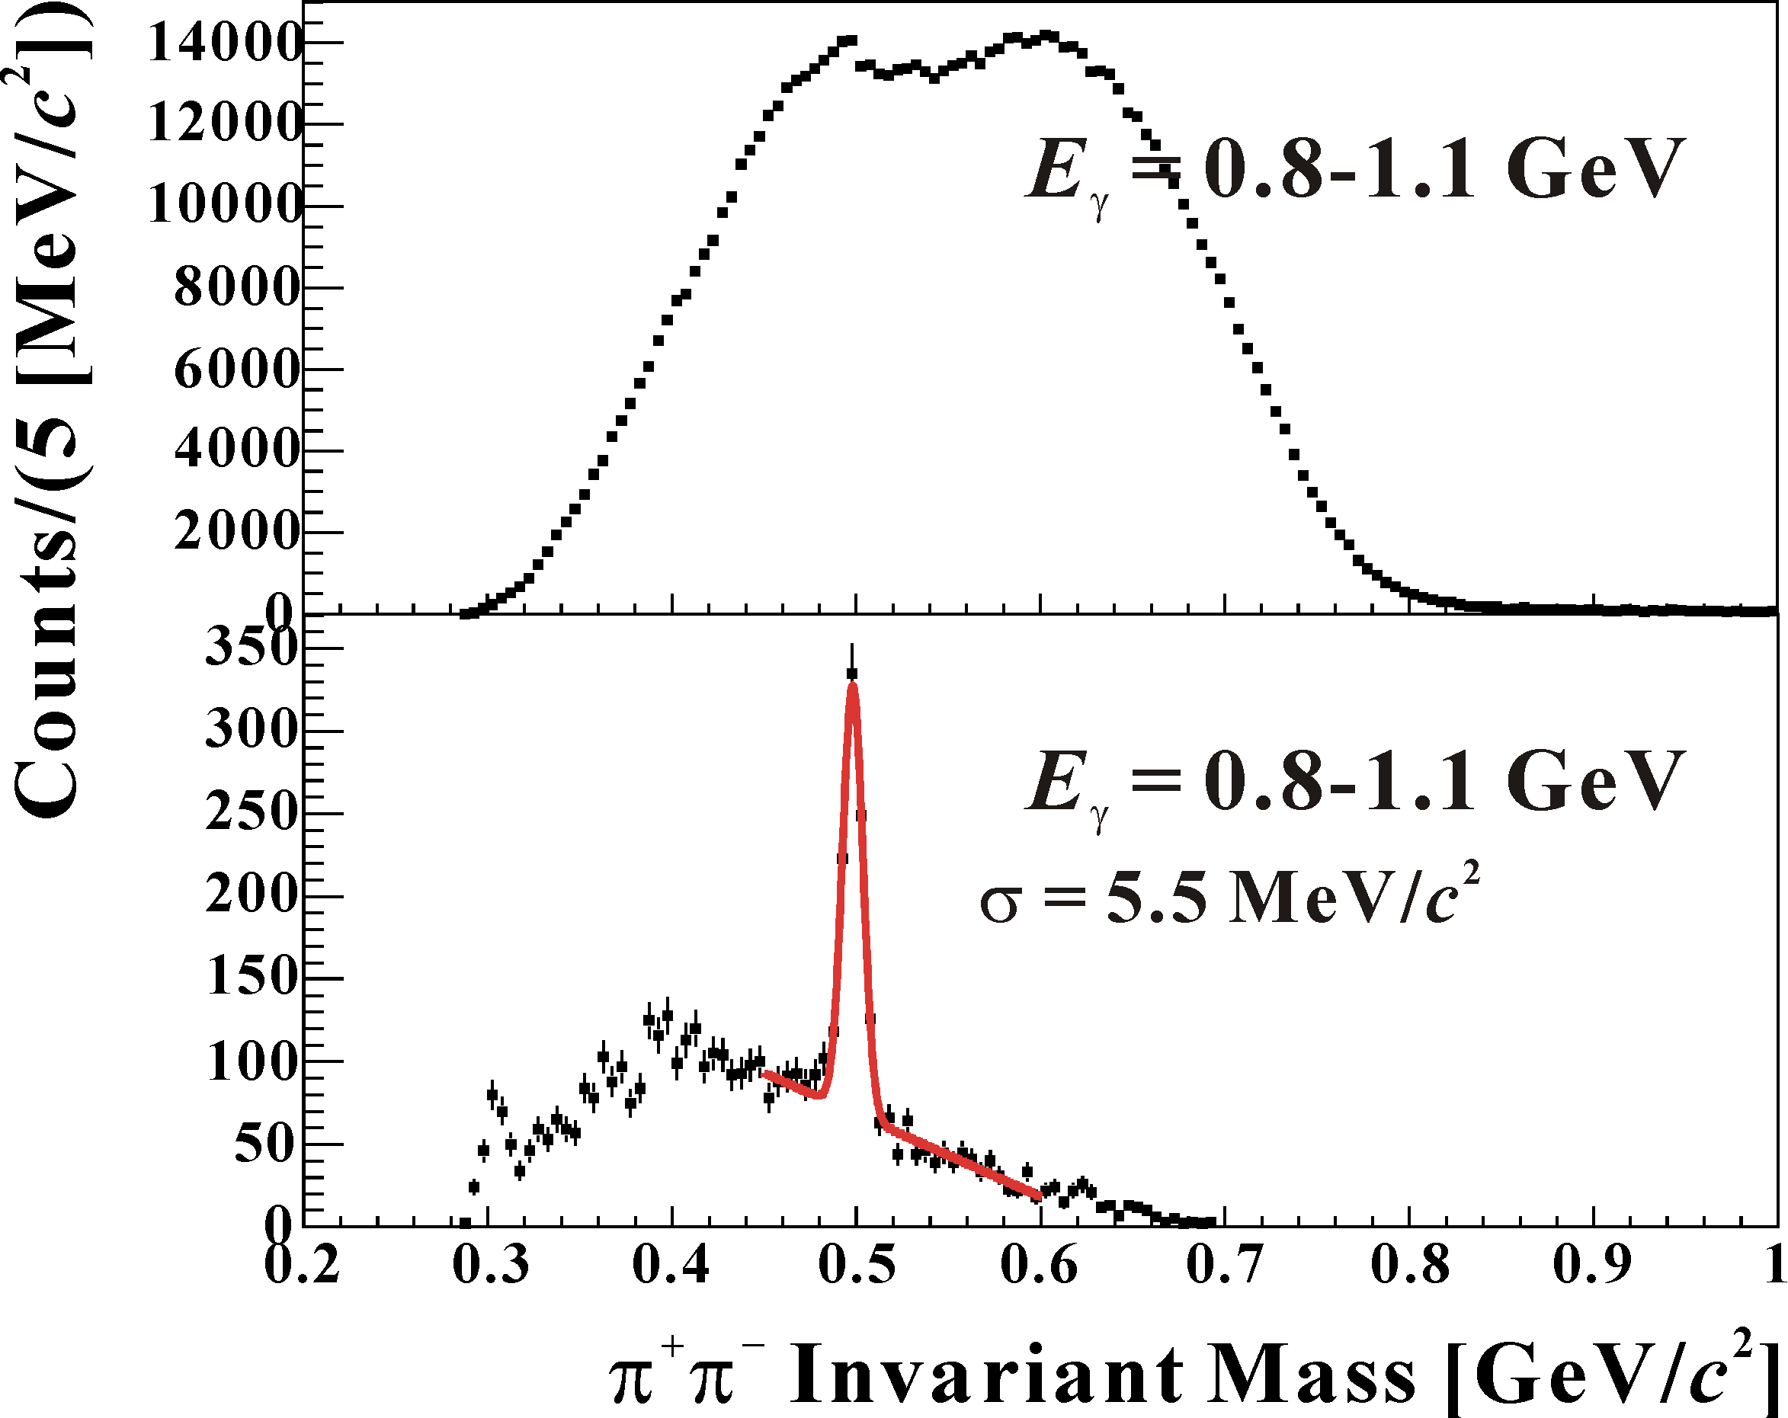
Background Rejection
- decay volume cut
No cut
Target cell
Decay vertex resolution
1.1mm for horizontal
4.2mm for vertical

Slide 33
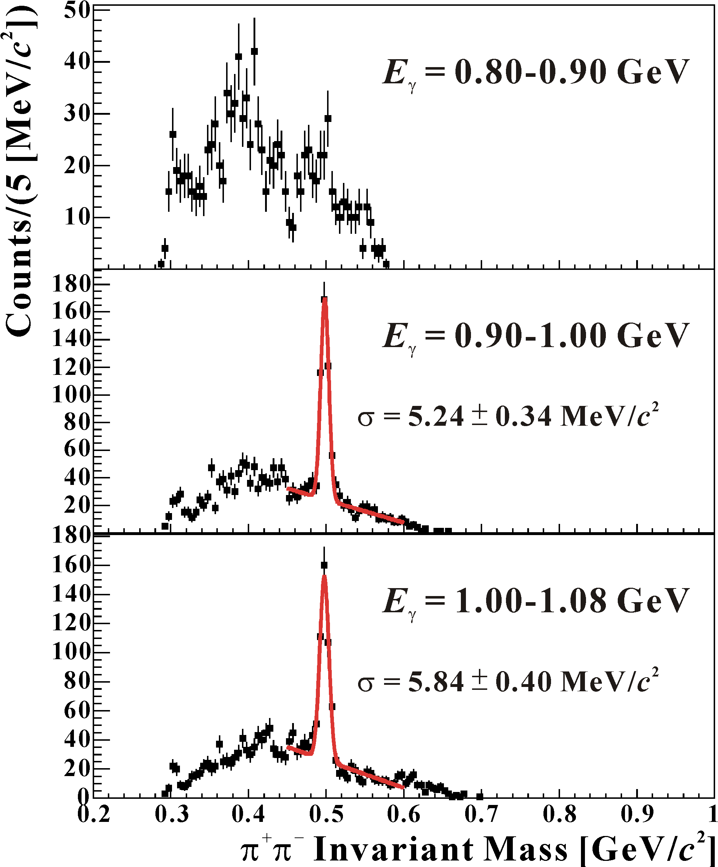
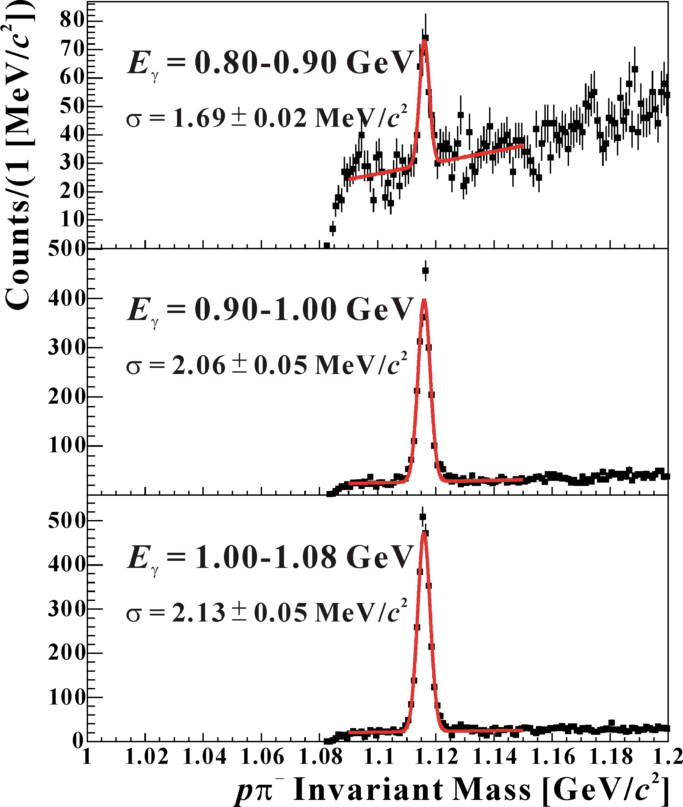
Invariant Mass Distributions

Slide 34
Differential Cross Section
γ + d → K⁰ + X
(mainly γ + n → K⁰ + Λ)
E_{γ} = 0.90 – 1.00 GeV
dσ/dp_{Lab} [μb/(GeV/c)]
E_{γ} = 1.00 – 1.08 GeV
p_{Lab} [GeV/c]
Error bars : statistical only

Slide 35
Differential Cross Section
γ + d → Λ + X
(mainly γ + n → K⁰ + Λ
and γ + p → K⁺ + Λ)
E_{γ} = 0.90 – 1.00 GeV
dσ/dp_{Lab} [μb/(GeV/c)]
E_{γ} = 1.00 – 1.08 GeV
p_{Lab} [GeV/c]
Error bars : statistical only

Slide 36
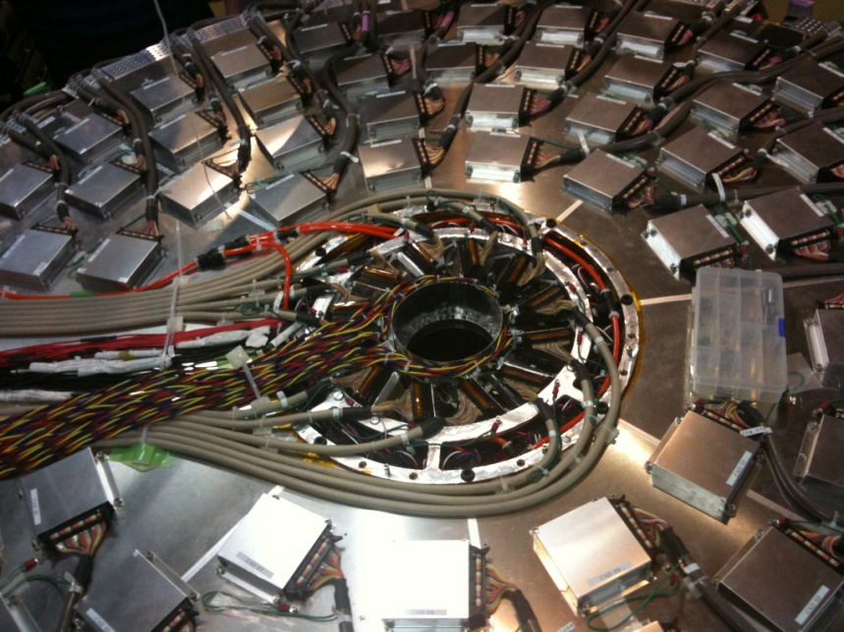
Comparison with models
モデルとの比較

Slide 37
Models near the threshold
Effective Lagrangian Approach
also knows as Isobar model
Rigge Plus Resonance Model

Slide 38
Theoretical Study: Effective Lagrangian Approach
γ
K
Hadron coupling
Isospin symmetry
Electromagnetic (photo) coupling
Helicity amplitude
Charged and neutral nucleon resonances
Decay width
Charged and neutral Kaon resonances
s channel
N
N*
Δ,
Δ*
N
Y
γ
K
K,K*,K₁
t channel
N
Y
However, the decay width of K₁ resonance is not known
γ
K
u channel
Y
Y*
N
Y
− 0.45 in Kaon-MAID, estimated
from γp→K⁰Σ⁺ data
Free parameter in Saclay-Lyon A
γ
K
Contact term
N
Y

Slide 39
Characteristics
of KΛ Channel
- comparison with KΣ
γ
K
In the s-channel exchange,
KΛ: N*
KΣ: N* and Δ*
N
Y
N, N*, Δ, Δ* , ....
s channel

Slide 40
Characteristics
of K⁰Λ Channel
- comparison with K ⁺Λ
No contribution of charge term in coupling constants
γ
K
γ
K
γ
K
K, K*, K₁, . . .
N
N*
Δ
Δ*
.
.
Y
Y*
.
.
N
Y
N
Y
N
Y
s channel
t channel
u channel

Slide 41
Models
 |  | Kaon -MAID | Saclay -Lyon A
Input data | γ+p→K⁺+Λ | ○ | ○
 | γ+p→K⁺+Σ⁰ | ○
 | γ+p→K⁰+Σ⁺ | ○
Resonances included in the model | N(1650) S₁₁ | ○
 | N(1710) P₁₁ | ○
 | N(1720) P₁₃ | ○ | ○
 | Δ(1900) S₃₁ | ○
 | Δ(1910) P₃₁ | ○
 | K*(892) | ○ | ○
 | K₁ (1270) | ○ | ○
 | Λ(1405) |  | ○
 | Λ(1670) |  | ○
 | Λ(1810) |  | ○
 | Σ(1660) |  | ○
Hadronic form factor |  | ○
contact term |  | ○
Kaon-MAID
T.Mart, C.Bennhold
PRC61 (2000) 012201(R)
Saclay-Lyon A
T. Mizutani et al.
PRC58 (1998) 75

Slide 42
Comparison with Isobar Models
γ + d → K⁰ + X, E_{γ} = 0.90 – 1.00 GeV
Kaon-MAID
All
K⁰ Λ
K⁰ Σ⁰
K⁰ Σ⁺
dσ/dp_{Lab} [μb/(GeV/c)]
Saclay-Lyon A
rkk = -1.0
rkk = -1.5
rkk = -2.0
Kaon-MAID
All
p_{Lab} [GeV/c]
Error bars : statistical only

Slide 43
Comparison with Isobar Models
γ + d → K⁰ + X, E_{γ} = 1.08 – 1.08 GeV
Kaon-MAID
All
K⁰ Λ
K⁰ Σ⁰
K⁰ Σ⁺
dσ/dp_{Lab} [μb/(GeV/c)]
Saclay-Lyon A
rkk = -1.0
rkk = -1.5
rkk = -2.0
Kaon-MAID
All
p_{Lab} [GeV/c]
Error bars : statistical only

Slide 44
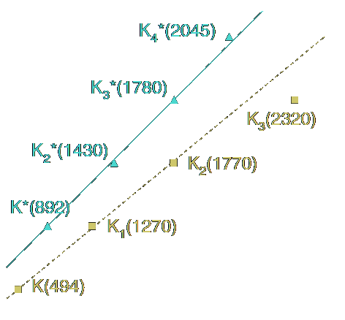
Regge Plus Resonance (RPR) Model
Invariant Amplitude
Phys.Rev.C73 045207
T. Corthals et al.
M = M_{background} (Regge) + Σ M_{s}(Isobar)
K*(892) Trajectory
K(494) Trajectory
γ
K
4
3
α(t)
2
N
Y
N, N*, Δ, Δ* , ....
1
s channel
0
0
2
3
4
5
6
N(1650) S₁₁ , N(1710) P₁₁ N(1720)P_{13,}
N(1720) P₁₃ N(1900) D₁₃
Δ(1900) S₃₁ Δ(1910) P₃₁
1
t [GeV/c²]
Notes:
弦理論の話であったように、スピンと mass squared がだいたい比例している

Slide 45
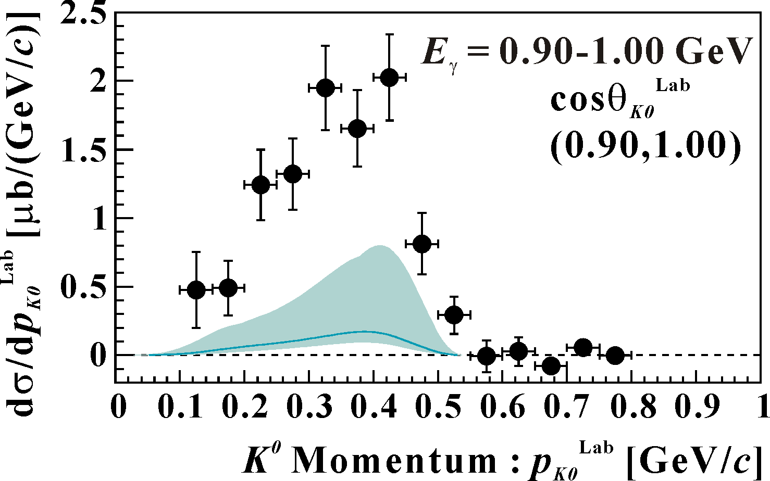
Comparison with RPR Model
Calculation of RPR Model
E_{γ} = 0.9-1.0 GeV, cosθ_{K0}^{Lab} = 0.9-1.0
Nucleon Resonances in the KΛ process
N(1650) S₁₁, N(1710) P₁₁, N(1720) P₁₃,
N (1900) P₁₁, N(1900) D₁₃
N(1900) D₁₃ : Missing Resonance
No data to helicity amplitude of N(1900) D₁₃
→
From -2.0 To 2.0 (Cyan Line 0.0)
Our results are two times larger than the calculations of RPR at least
P.Vancraeyveld et al.: private communication

Slide 46
Kaon Angle distribution in CM
K⁰Λ: Backward Distributions (fitting results)
K⁺Λ: Forward Distributions (SAPHIR, CLAS)
SAPHIR: K. H. Glander et al., Eur. Phys. J., A19:251–273, 2004.
CLAS: R. Bradford et al., Phys. Rev., C73:035202, 2006.

Slide 47
Summary
まとめ

Slide 48
Investigating strangeness photo-production
via γ + n → K ⁰_{S} + Λ channel
using the NKS2 spectrometer at ELPH, Tohoku Univ.
Differential cross sections of K ⁰_{S} and Λ in γ+d
K ⁰_{S}
Larger angle coverage than previous experiment
Λ
The first measurement
K ⁰_{S} + Λ total cross section estimated
similar shape to K ⁺ + Λ as a function of E_{γ}
Suggestion from comparison of data with models
Angular distribution
backward enhance in K ⁰_{S} + Λ
(K ⁺ + Λ: slightly forward peak)
Detector upgrade was done and we took new data

Slide 49
Upgrade Project
To increase acceptance
Inner detectors are replaced
by
Vertex Drift Chamber (VDC)
New Inner Hodoscope (IH)

Slide 50
VDC
IH

Slide 51
Back up
予備

Slide 52
Detector Setup
Counters
Inner and Outer Hodoscope
Electron Veto
Drift chambers
CDC: Honeycomb cell
SDC: Straw Drift chamber
γ beam
γ
1 m

Slide 53
Results of NKS
NKS

Slide 54
Suggestion from NKS Results
backward angular distribution in CM
NKS

Slide 55
Suggestion from NKS Results
10
γ+n →K⁰+Λ
σ [μb]
Saclay-Lyon A
Kaon-MAID
before
5
0.9
1.0
1.1
1.2
1.3
1.4
1.5
E_{γ} [GeV]
after
NKS

Slide 56
NKS to NKS2
NKS
NKS2
Improved Acceptance
by covering forward region
Notes:
Here is a comparison of NKS2 to NKS
The left-hand side is a schematic view of NKS, and the right-hand side is NKS2.
To avoid high rate back-ground, NKS is opened on beam line.
On the other hand, K zero acceptance become small due to this region.
It was necessary to cover this region to improve the acceptance.
The K zero acceptance in NKS2 becomes more than three times of NKS

Slide 57
Comparison with Isobar Models
γ + d → Λ + X
E_{γ} = 0.90 – 1.00 GeV
Saclay-Lyon A
rkk = -1.0
rkk = -1.5
rkk = -2.0
Kaon-MAID
All
dσ/dp_{Lab} [μb/(GeV/c)]
E_{γ} = 1.00 – 1.08 GeV
p_{Lab} [GeV/c]
Error bars : statistical only

Slide 58
Integral Cross Section : Inclusive Λ
Integral Region : cosθ_{Λ}^{Lab}=0.9-1.0
Error : statistical error
Systematic Uncertainty : < 14 %

Slide 59
Total Cross Section γ+d→ K⁺+Λ+n Estimated
[1] K. H. Glander et al., Eur. Phys. J., A19:251–273, 2004.
[2] M. Q. Tran et al., Phys. Lett., B445:20–26, 1998.

Slide 60
Strange TDC distribution
We found that there are many hits
in unexpected TDC range
Negative value
hit time after common stop
0xFxxxx is continued in negative region as accidental coincidence distribution
The module recorded hit after common stop
Program is needed to be modified
When this range is treated
as negative value

Slide 61
Beam Test in 2010/4/26-28
Changing TDC module parameters
Set a time window not to measure a time after Common Stop
One trigger configuration was tested (as the result)
Test was terminated due to a wire broken
Original
Set a time window
Red and Blue: different time window

Slide 62
Beam Test in 2010/６/1-4
Trigger Combination Check
w/ or w/o Electron Veto Counter in downstream region
To be biased or not to be
At ~2MHz beam rate, DAQ efficiency is ~65% (same order with run-2007)
Now, 29 AMT-VME boards
It was 21 in 2007
Test for reducing number of TDC modules
How effective to increase number of DAQ PC
results: about 1.15 times better at 2.0MHz beam rate

